Slide 1




Caddoodles
For girls entering 6th – 8th grade
A training camp for girls looking to gain experience in their camping skills as well as learning to train and become independent Caddie leaders.
Girls earn their Caddie training including:
Outdoor skills
Camp fires and cooking over a fire
Knives and knots
Tents and sleeping in tents
Ceremonies
Songs and games
Leadership skills
Along with fun activities
Adventure course
Archery
Carpentry

Slide 2
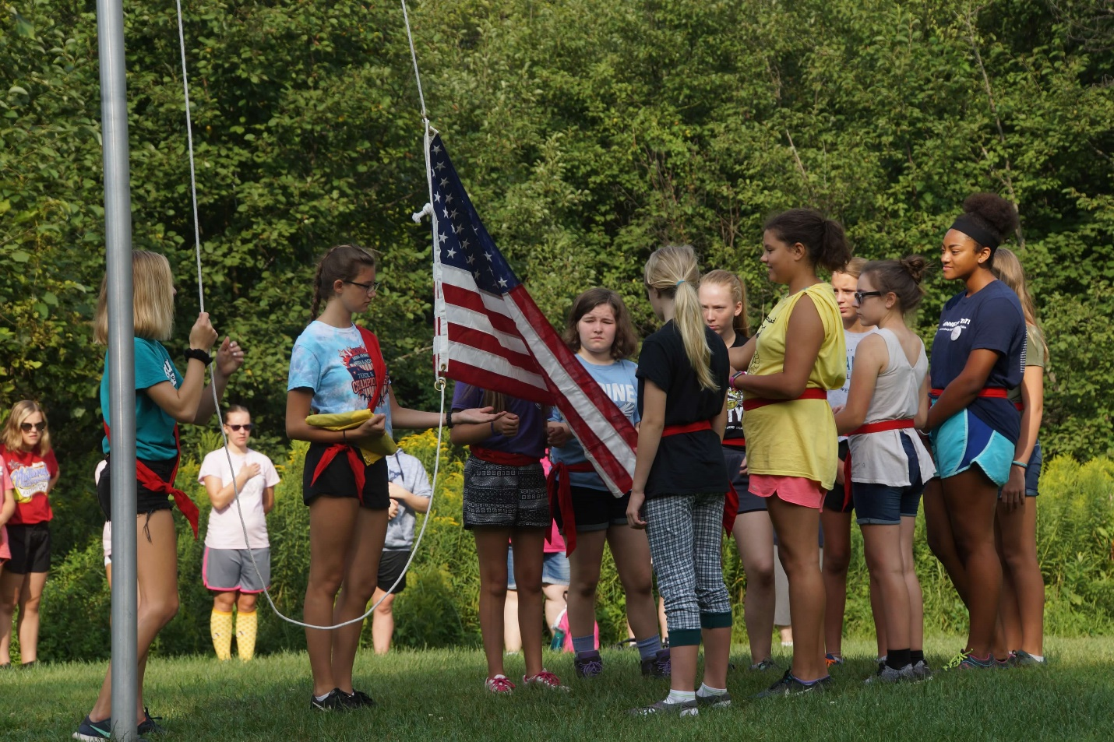
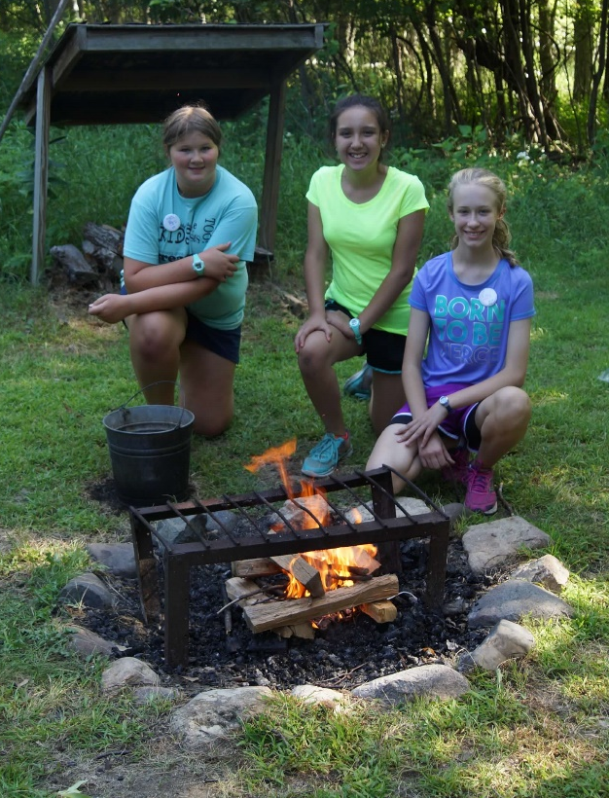
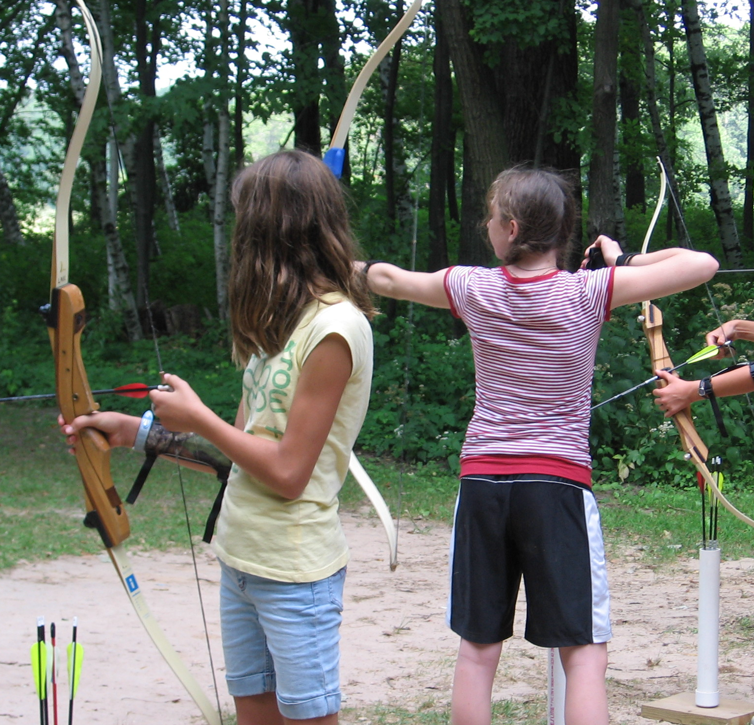
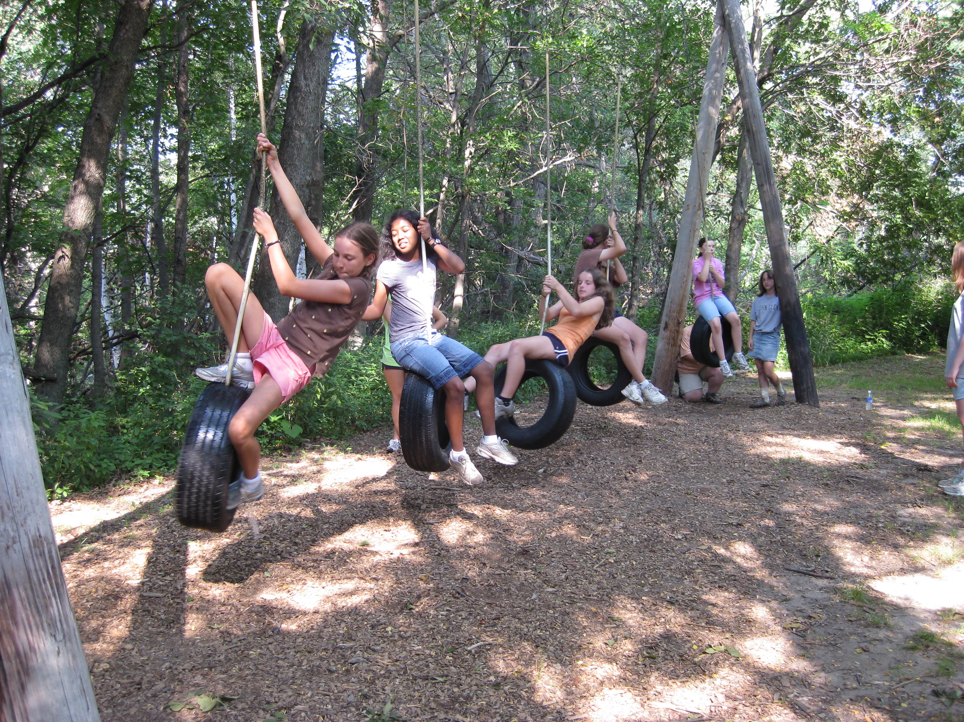
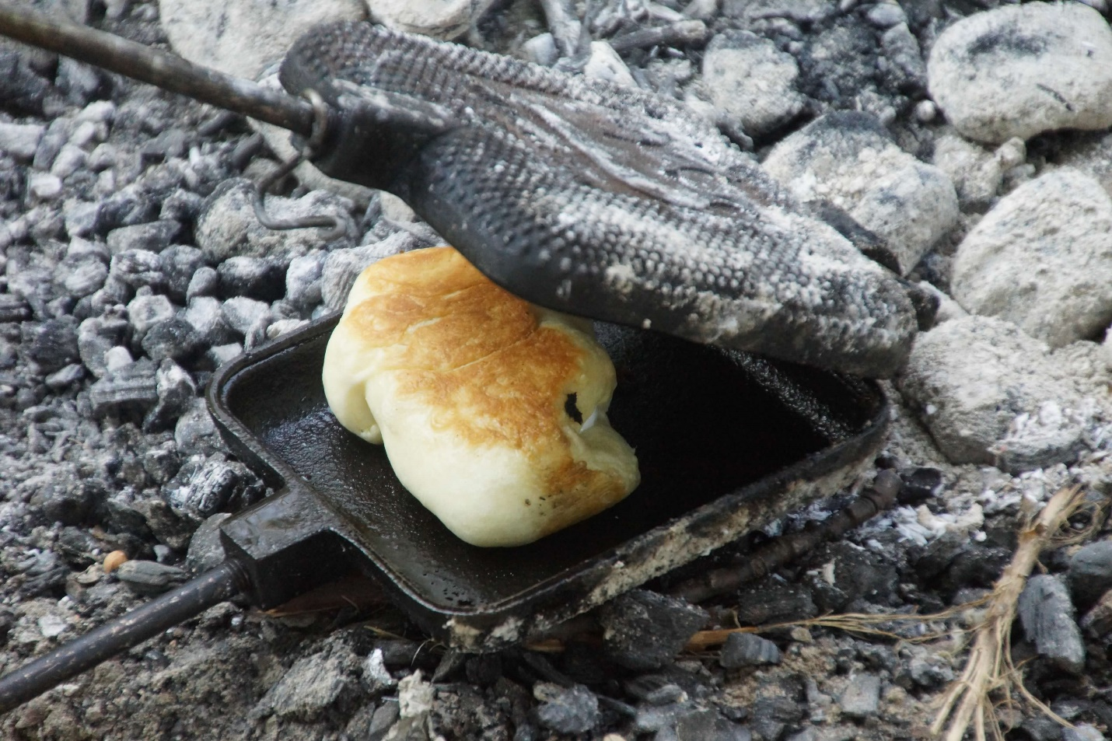
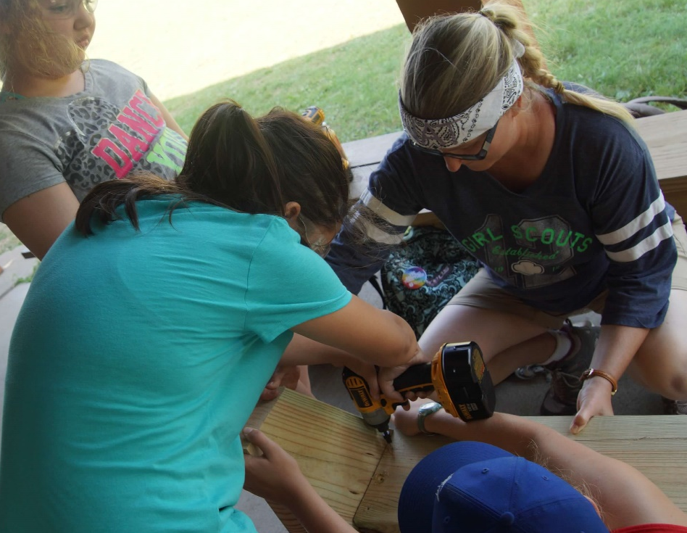
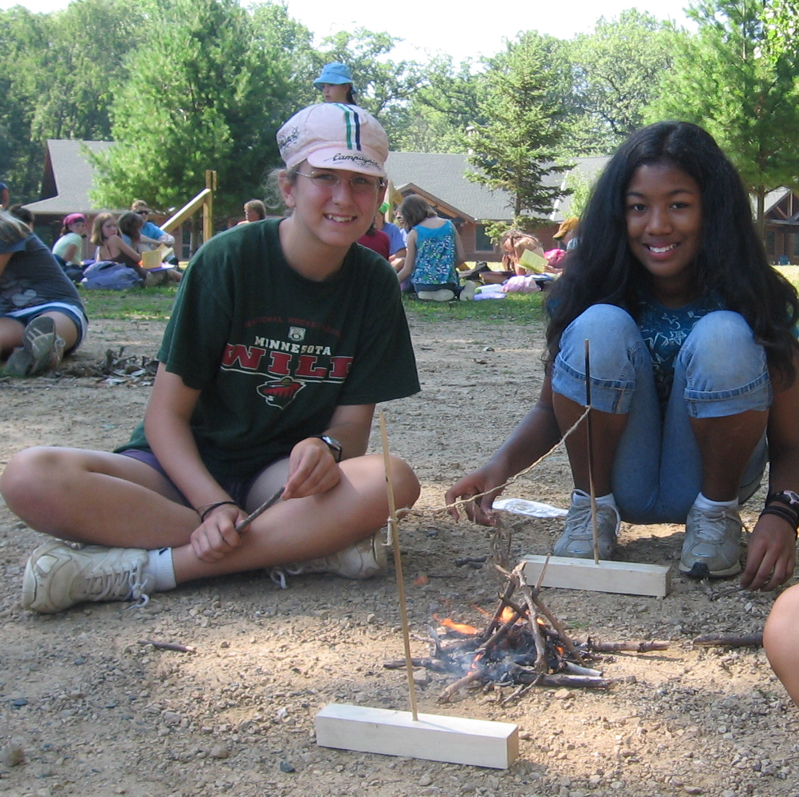

Slide 3
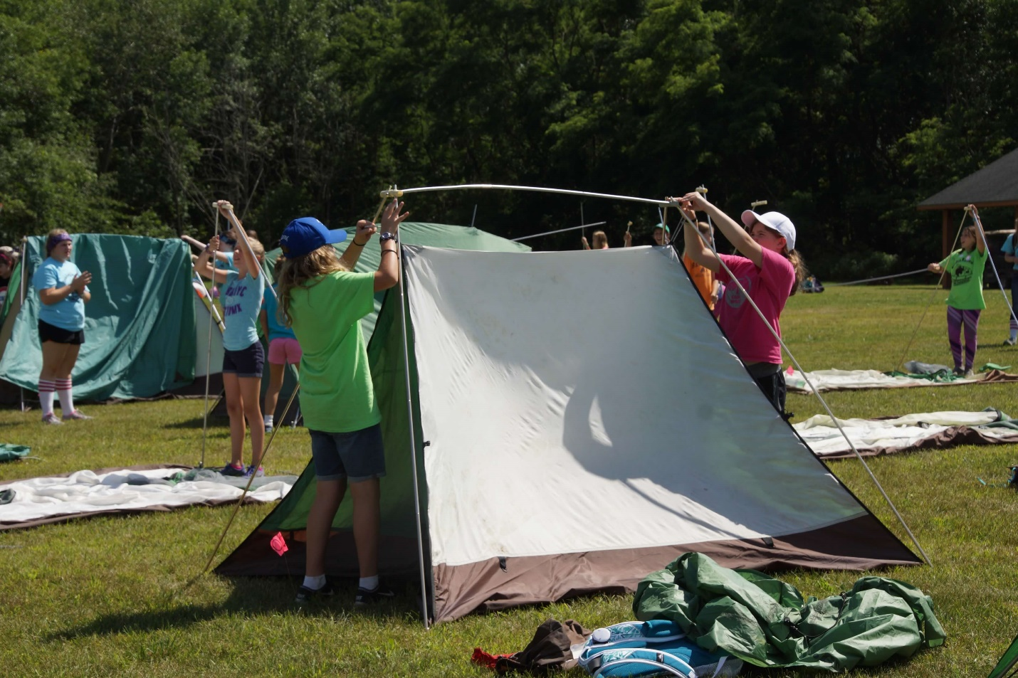
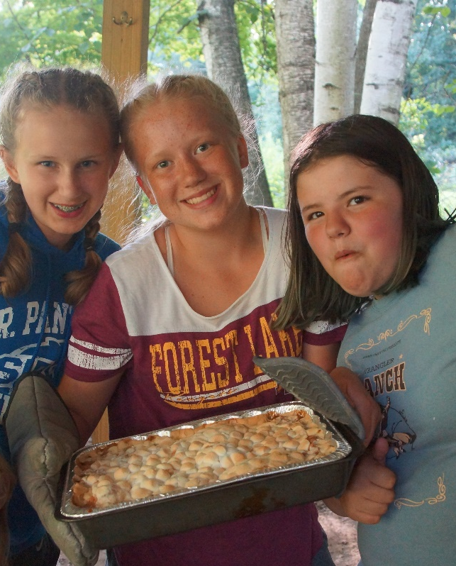
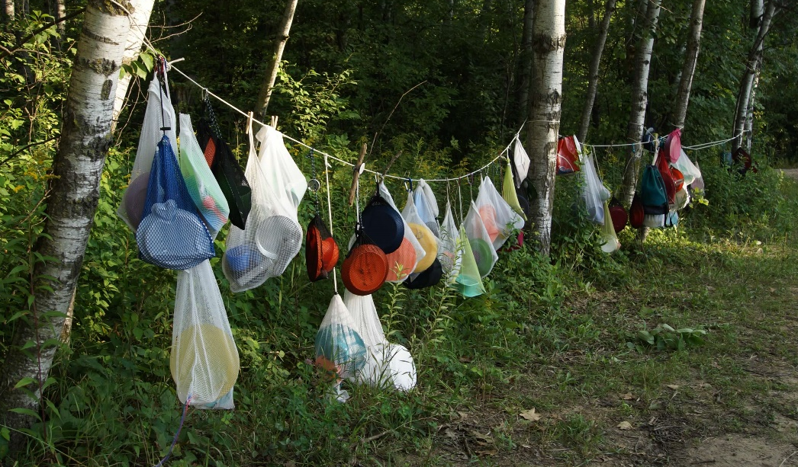
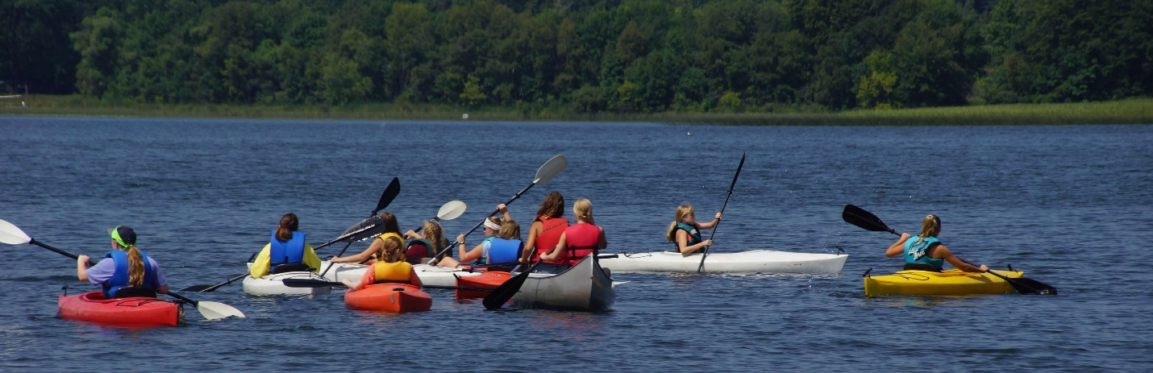
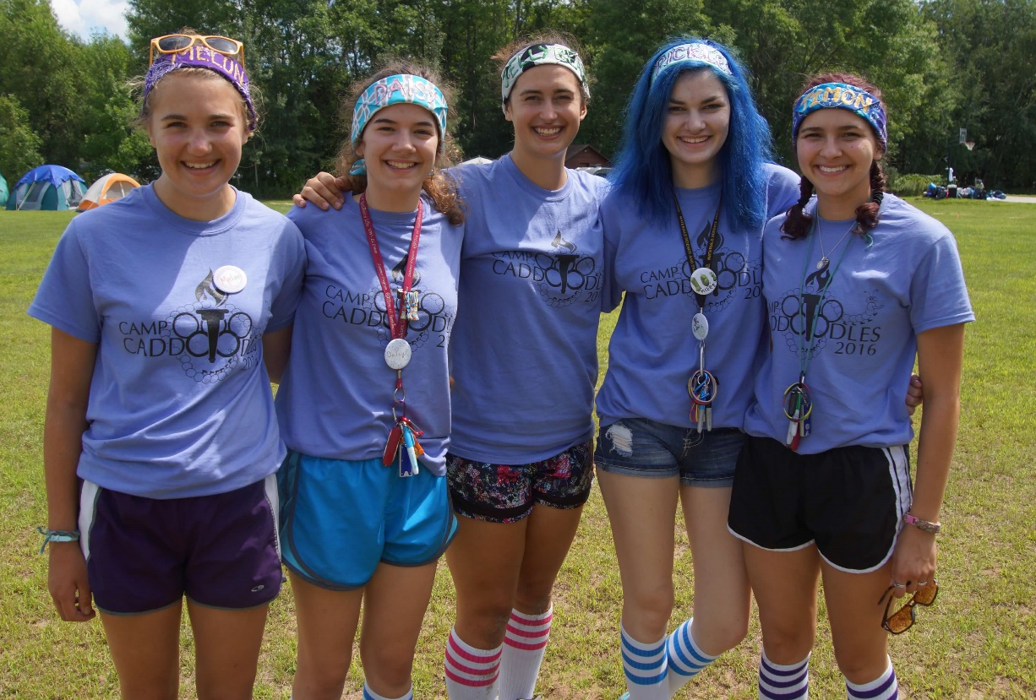
4 days – 3 nights
Second week of August at Camp Lakamaga
Check out www.caddoodles.org for more information on current dates, cost, registration forms and other general information or send emails to caddoodles@gmail.com

