Slide 1
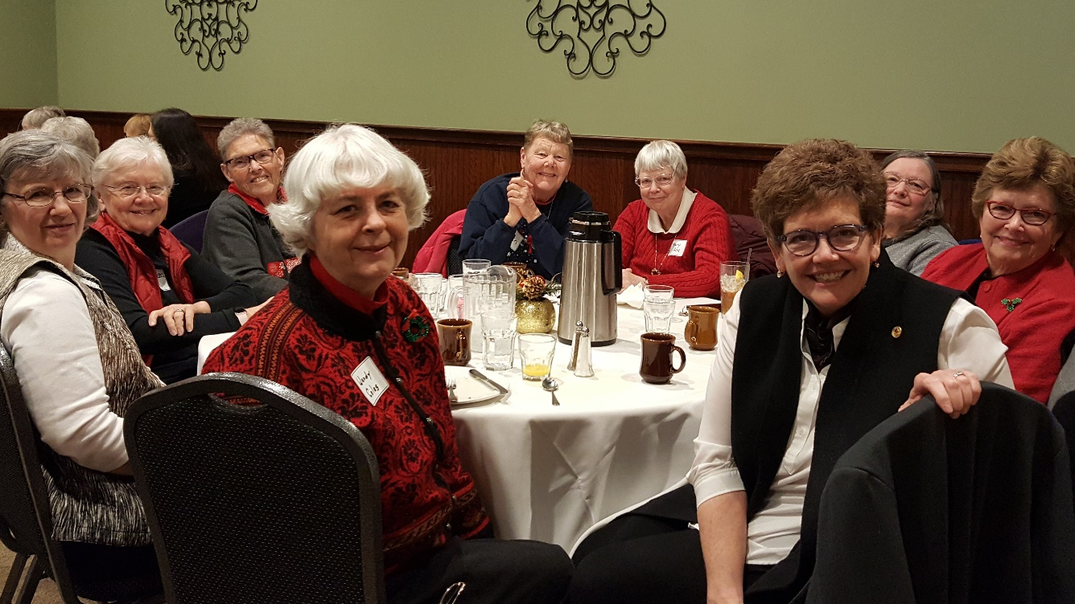
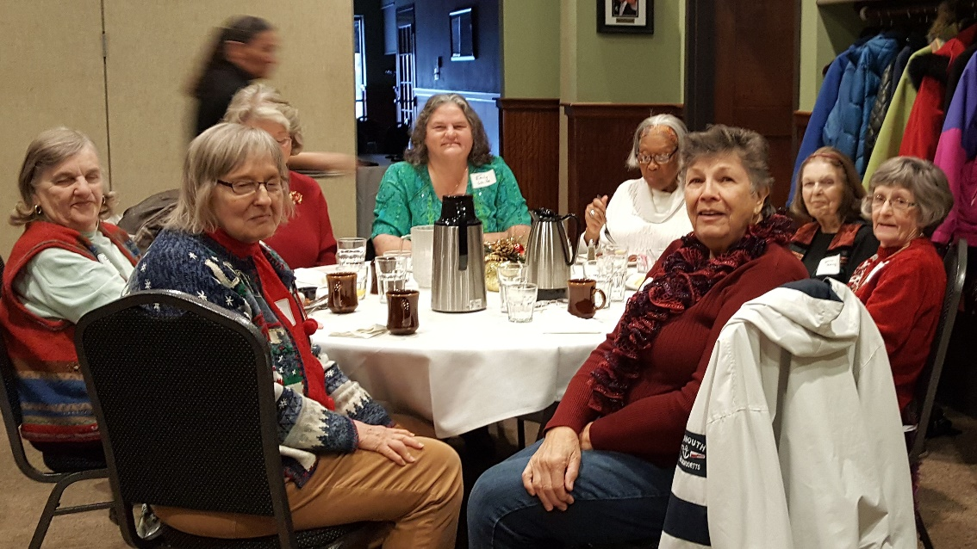
Friends Forever
Friends
Forever
This group gets together once a month on the second Monday of each month for breakfast

Slide 2
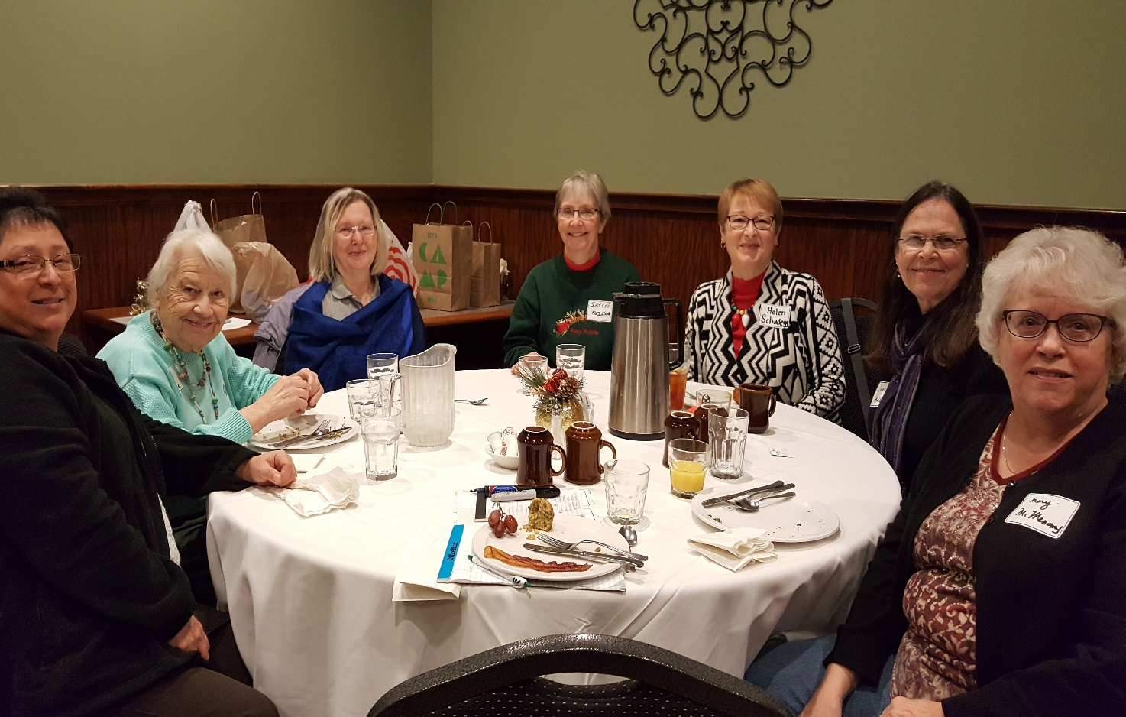
Once a year they host a Friends Forever Breakfast for any River Valleys
Alumnae who can attend to collect money and items for some chosen charity
(these pictures are from Christmas 2017)

