Slide 1



Second Winds Alumnae Chapter

Slide 2

About Second Winds………..
Purpose
  To promote outdoor fun within Girl Scouts
  To provide expertise in outdoor skills and program
  To provide assistance in planning, implementing, and staffing outdoor events, such as encampments
  To provide assistance to RV Council however needed in the area of outdoor program
Meetings
  Second Thursday in September and April; First Friday in December
Membership
  All Adults who have ever been registered with Girl Scouts or current Adult Girl Scouts are welcome to join
  Registrar: Terry Johnson (tltjohnson54@yahoo.com)
Scholarship for Destinations
  We provide scholarships to older girls attending Destinations

Slide 3
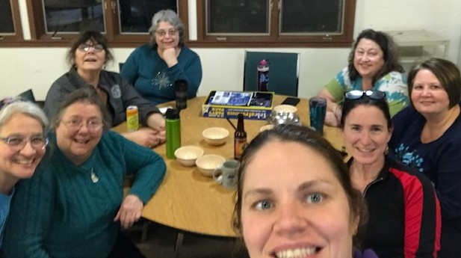
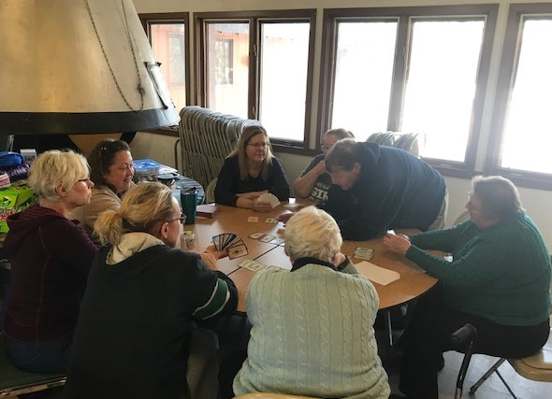
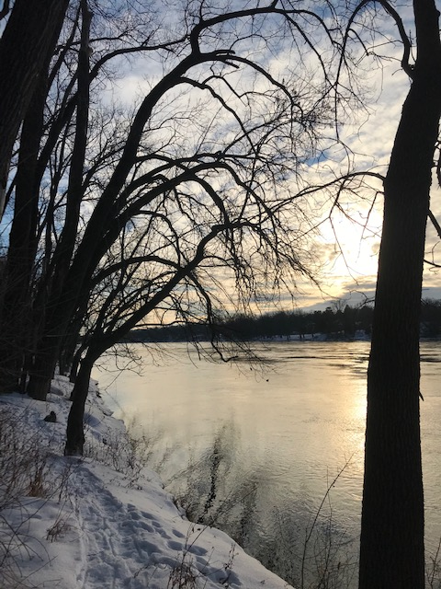
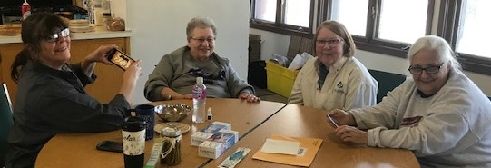
Second Winds Winter Encampment 2019 – Camp Lockeslea
Learning to play Trupe
(1939 Girl Scout Game)

