Slide 1
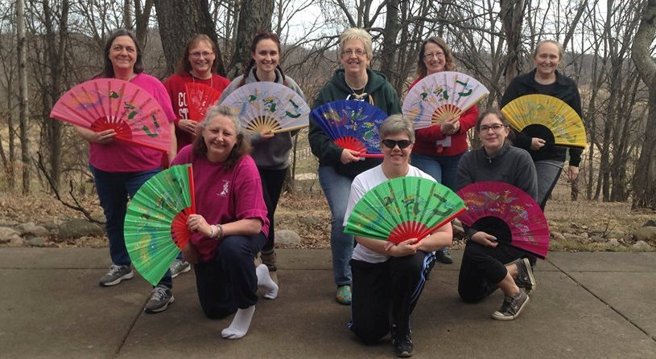
Connections Retreat
2000 - 2021
Camp Elk River
A weekend event for Girl Scout adult volunteers of RVGSC

Slide 2
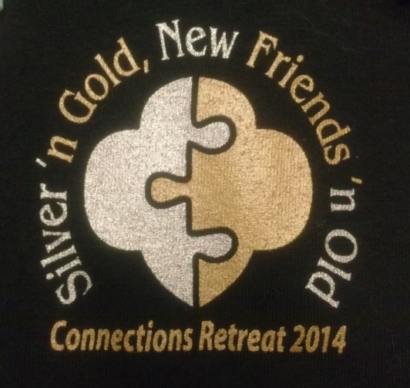
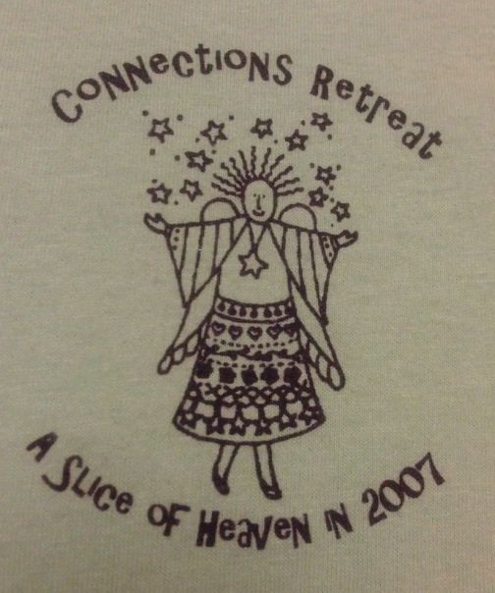

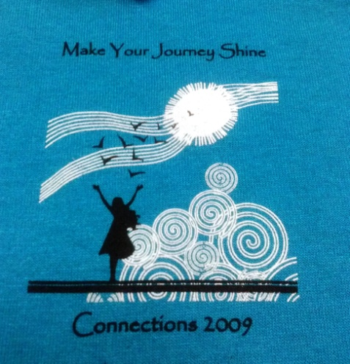
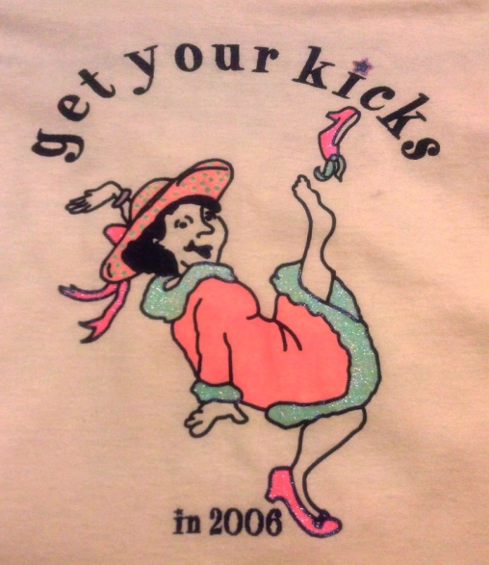
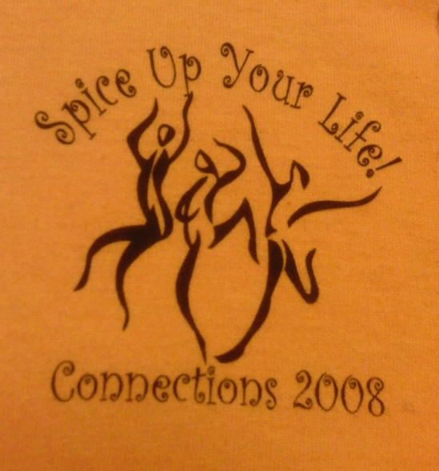
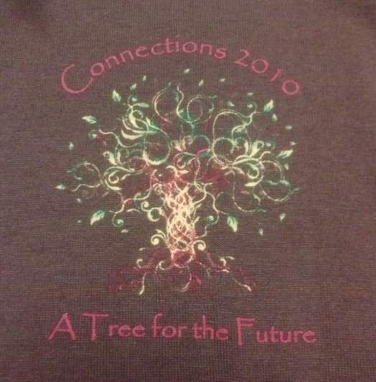
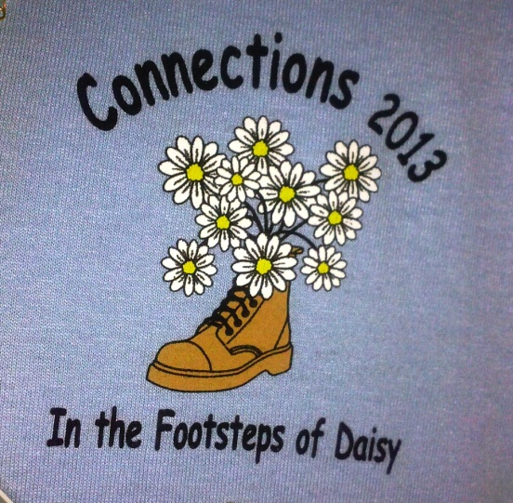
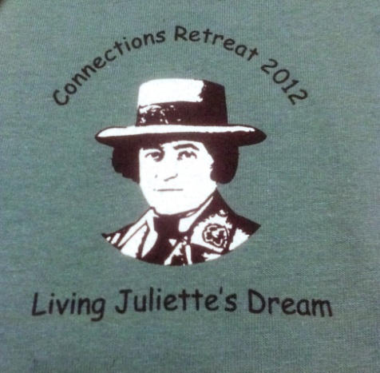
Connections through the years….

Slide 3
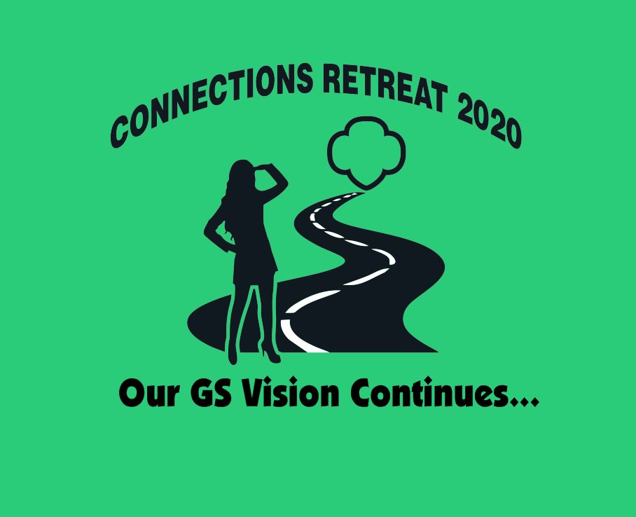
Connections Retreat
2020-21 : 2.0
Our GS Vision Continues
Save the date: Oct. 1-3, 2021
Camp Elk River, Gray Koch, Pines & Program Bldg.
Registration information available in August
For more information contact:
Stephanie Burton burtonsf@aol.com or
gsconnectionsretreat@sfly.com

