Slide 1
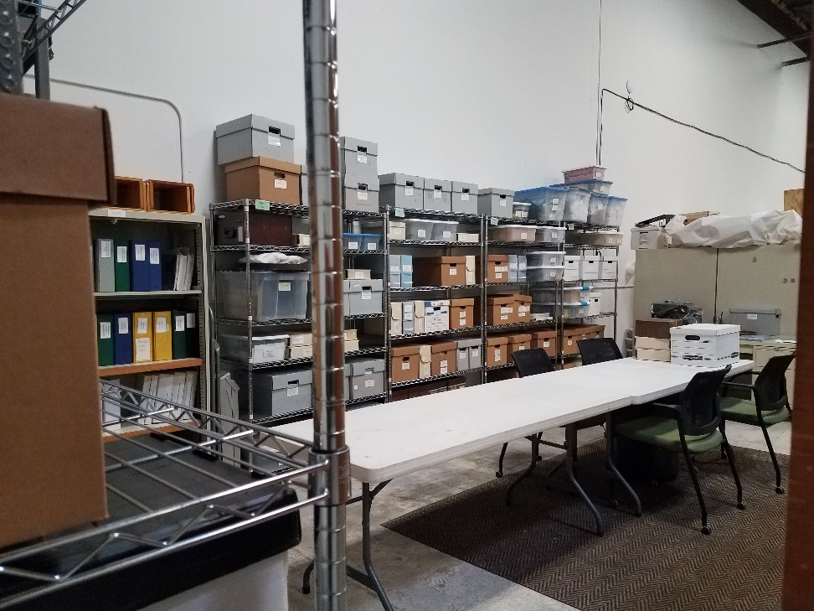
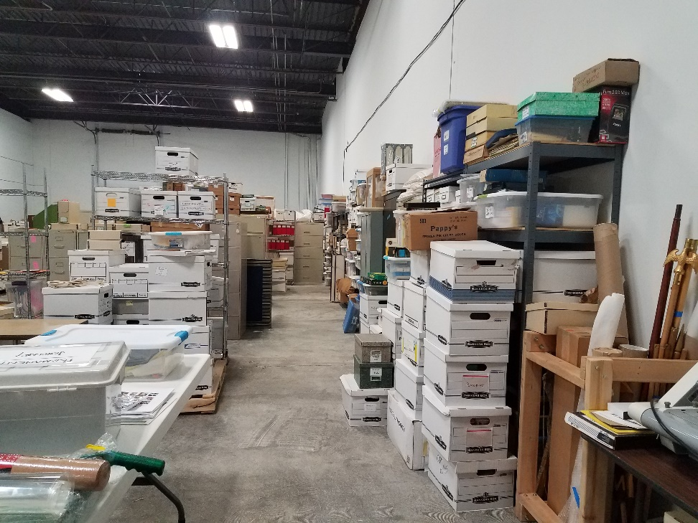
The Heritage Group is working on the collection of our history

Slide 2
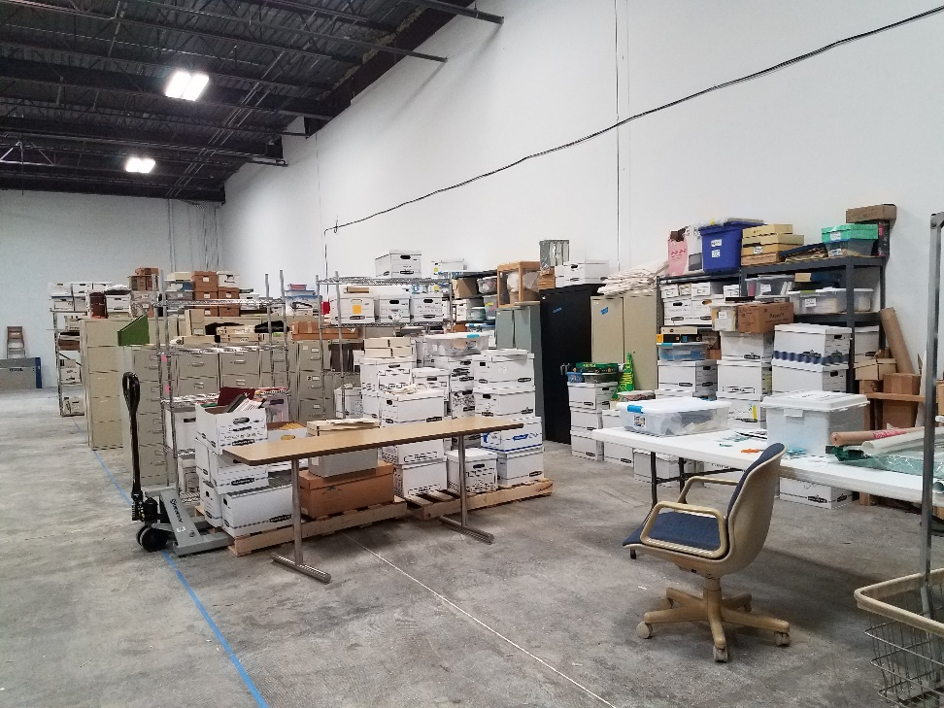
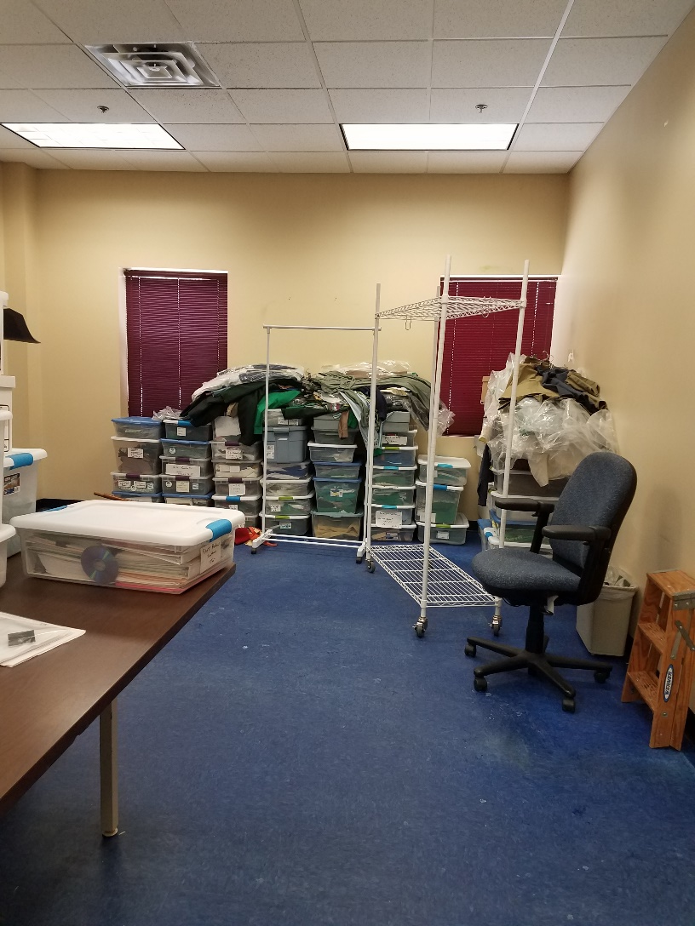
We are combining the five Legacy Councils into one collection at one location

Slide 3
It is good to have everything at one warehouse now
If you are interested in helping with the Heritage Group –
Call Council and they can help get you in touch with the group
We are always looking for help to get the collection organized

