Slide 1
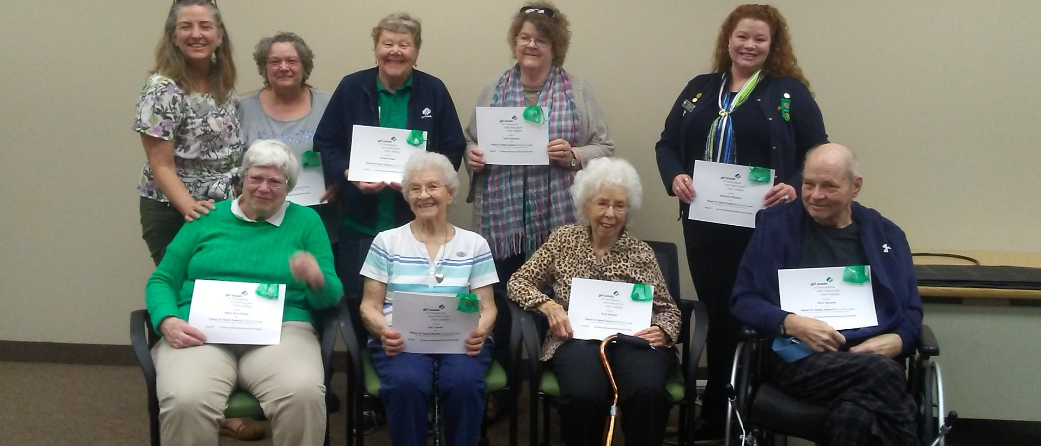
Tuesday Group
(This is from when the group was awarded the Heart in Hand Award in 2019)

Slide 2
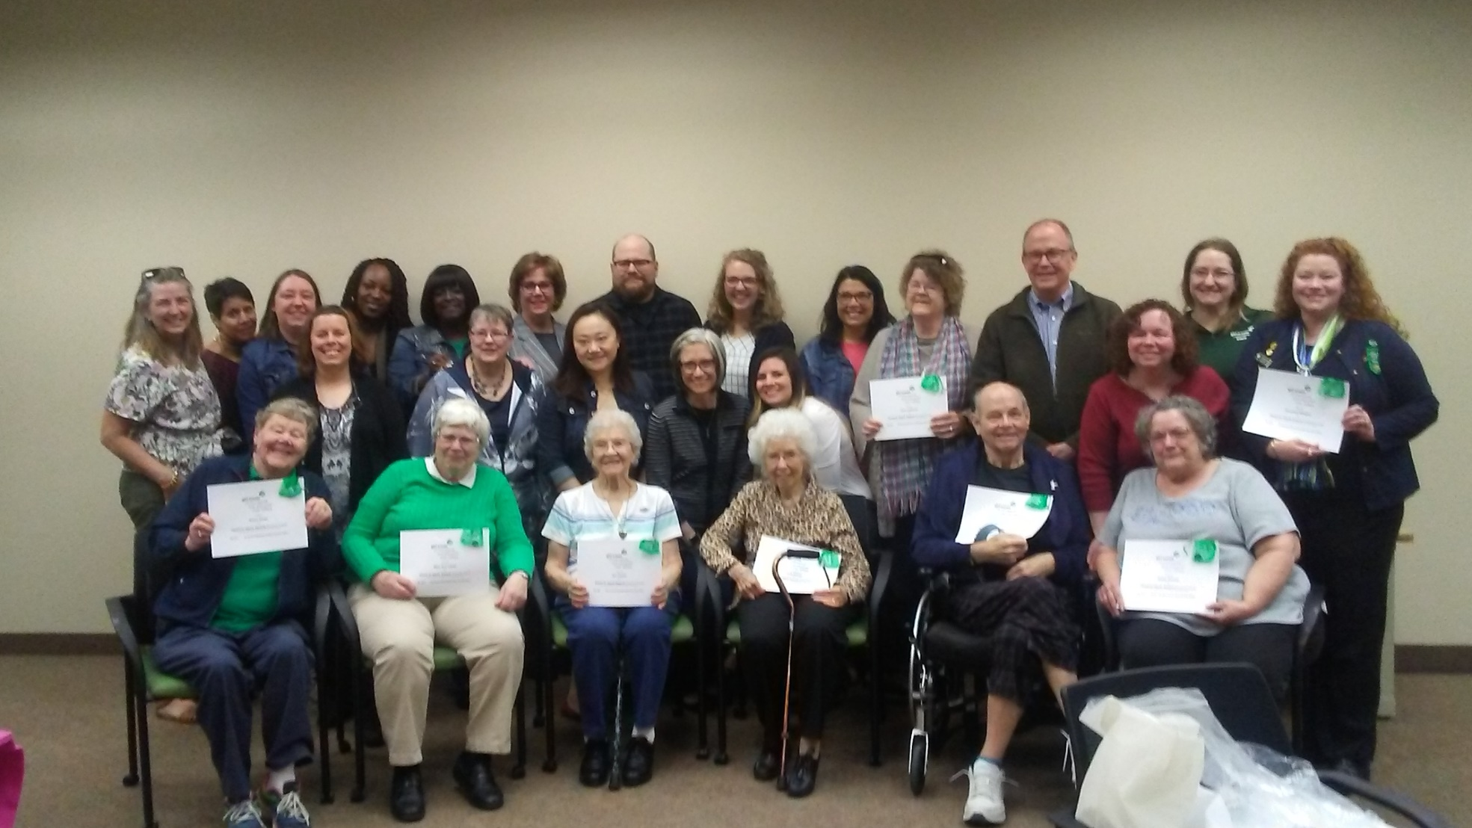
This group meets the second Tuesday every month to do administrative task(s) for council
It was nice that the employees at the Brooklyn Center Office came in to celebrate with us when we received our award

