Slide 1
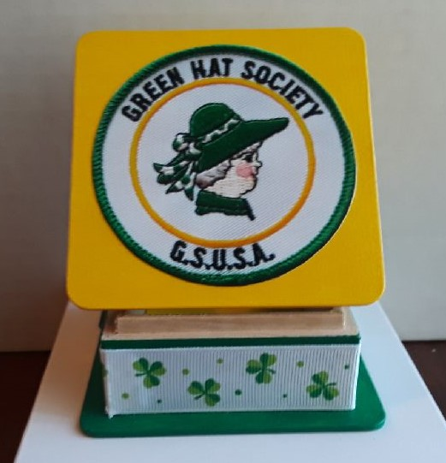
RIVER VALLEYS GREEN HATS SOCIETY – Chapter 16

Slide 2
Come Join us for some Fun
For information, please contact our Co-Chairs
Emily White at white.emily@comcast.net
  or
Teresa Foss at girlscoutfoss@gmail.com

