Slide 1
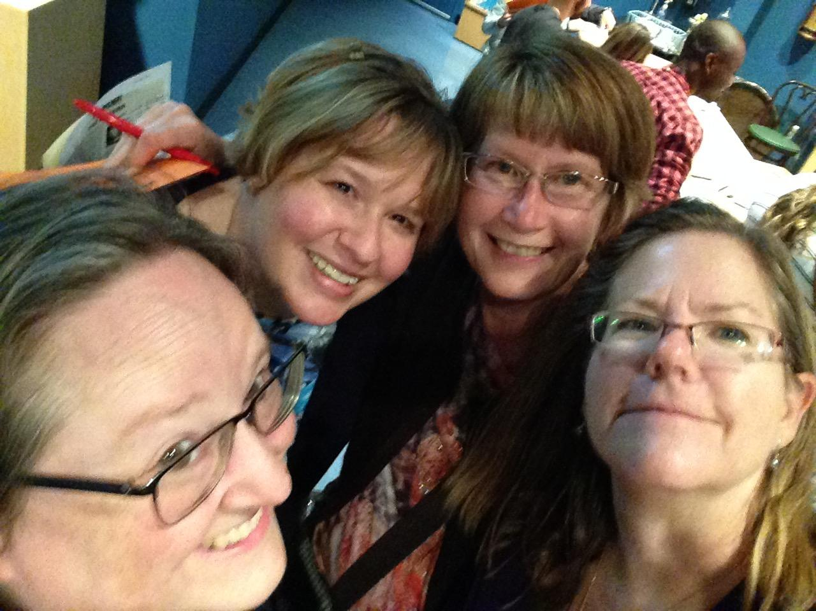
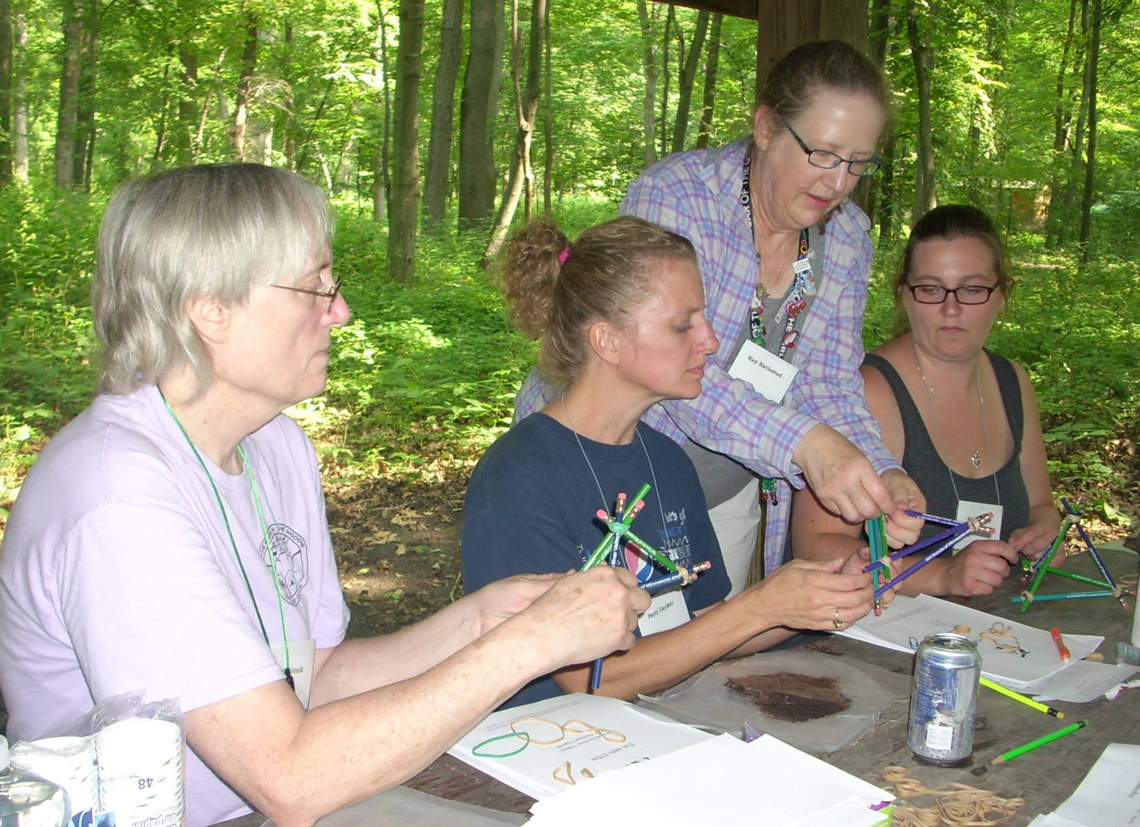
STEM* Group
Mission -
Provide opportunities and connections for GS Alums to be lifelong STEM learners and mentors
* Science, Technology, Engineering and Mathematics

Slide 2
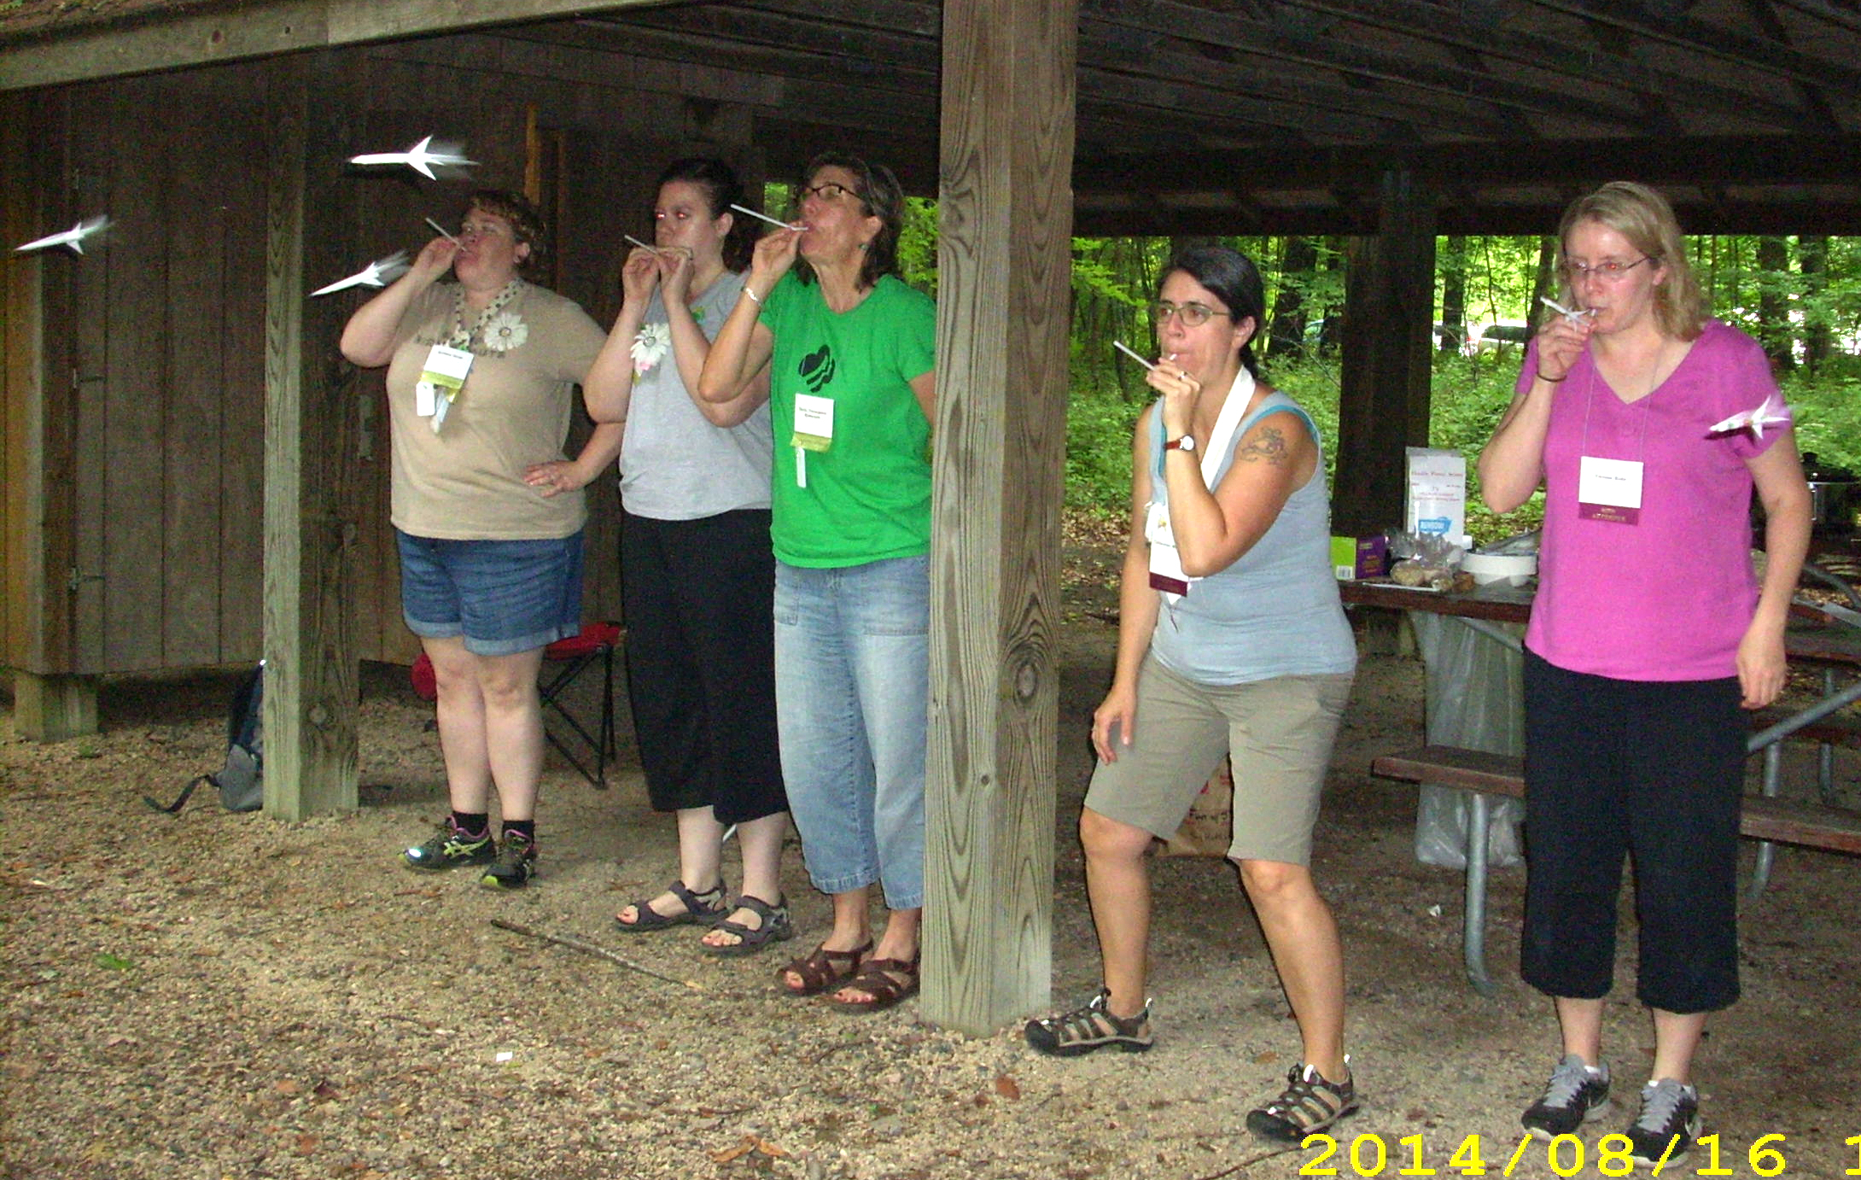
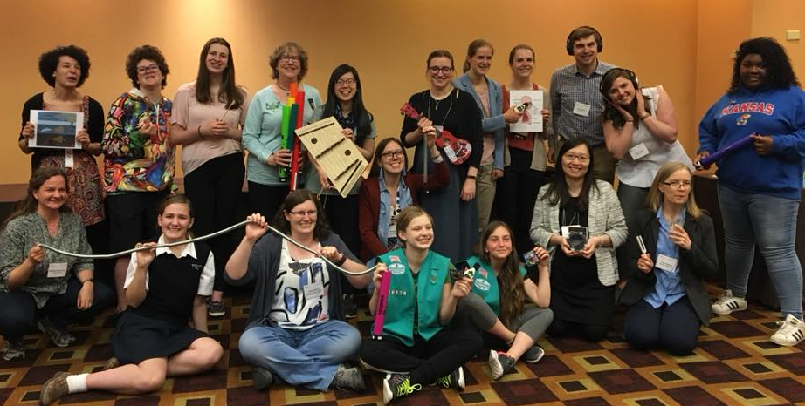
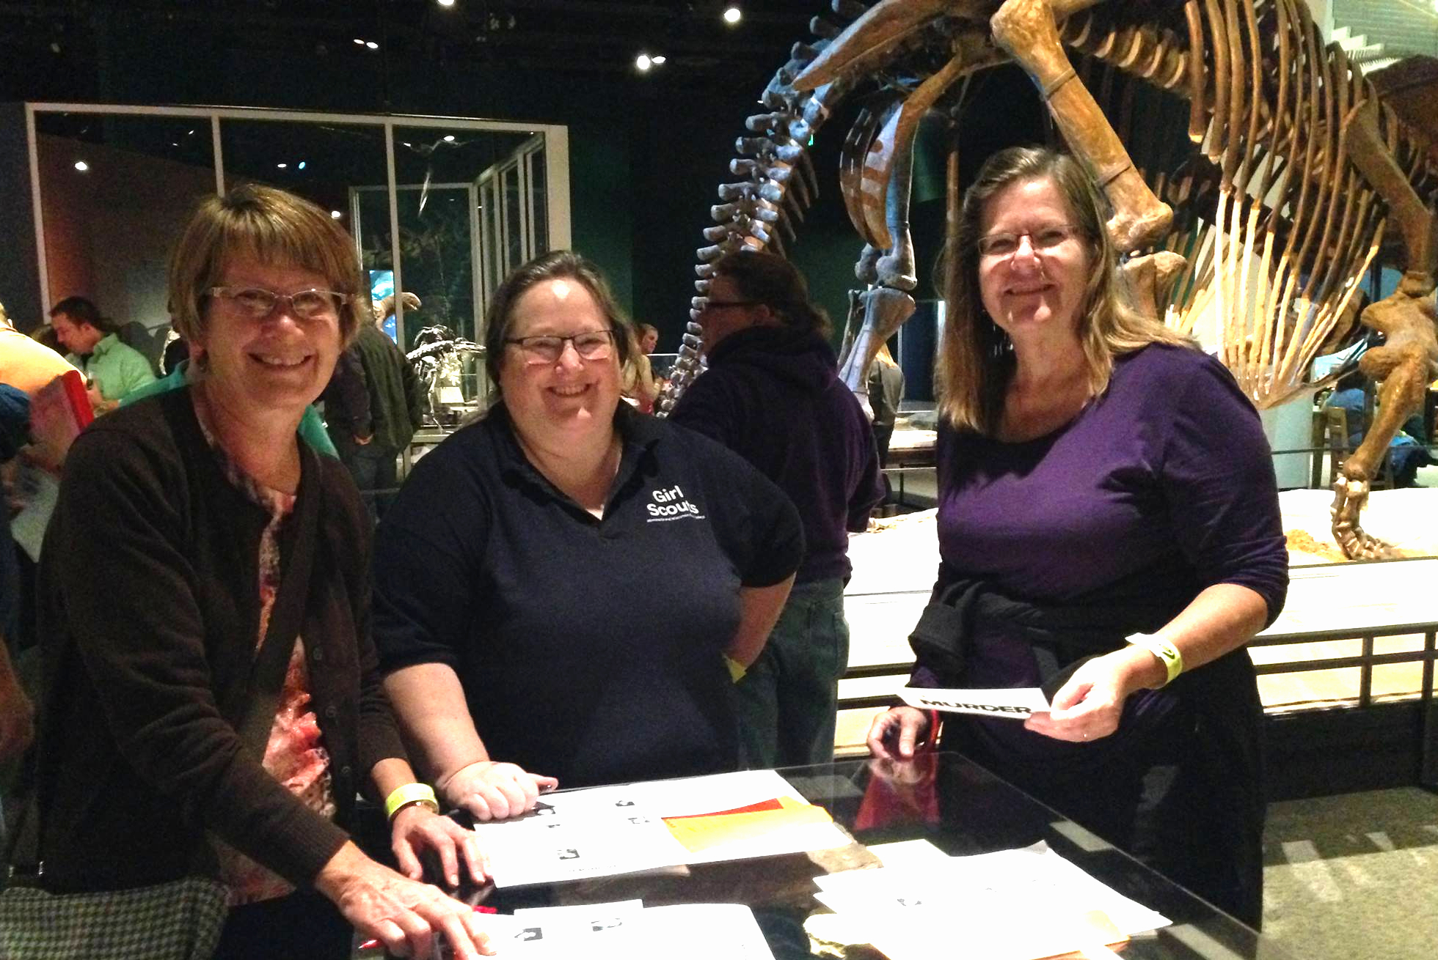
Activities:
Training sessions at Lakamaga Conference
Volunteer at Council and SU STEM events
Attend adult STEM-focused social events

Slide 3
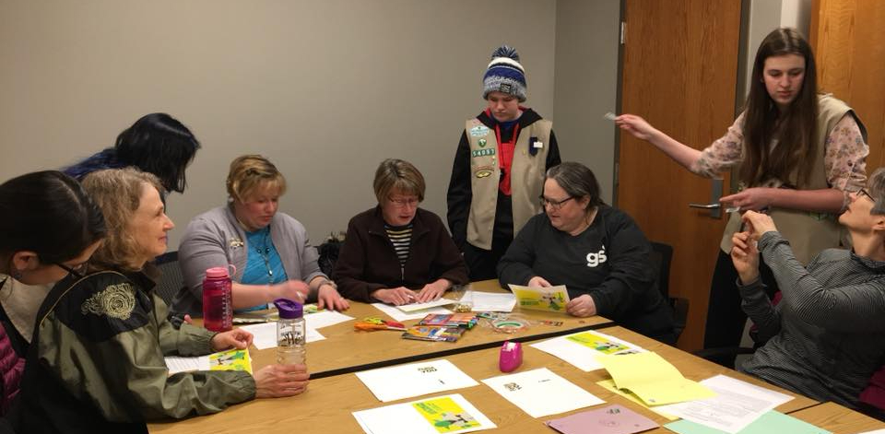
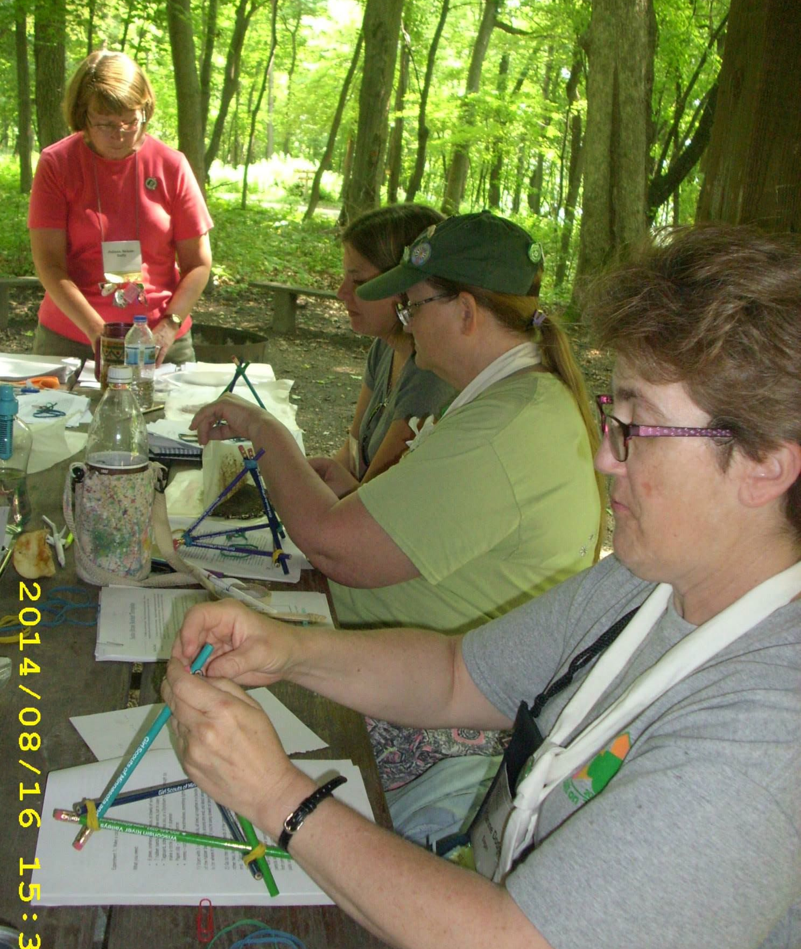
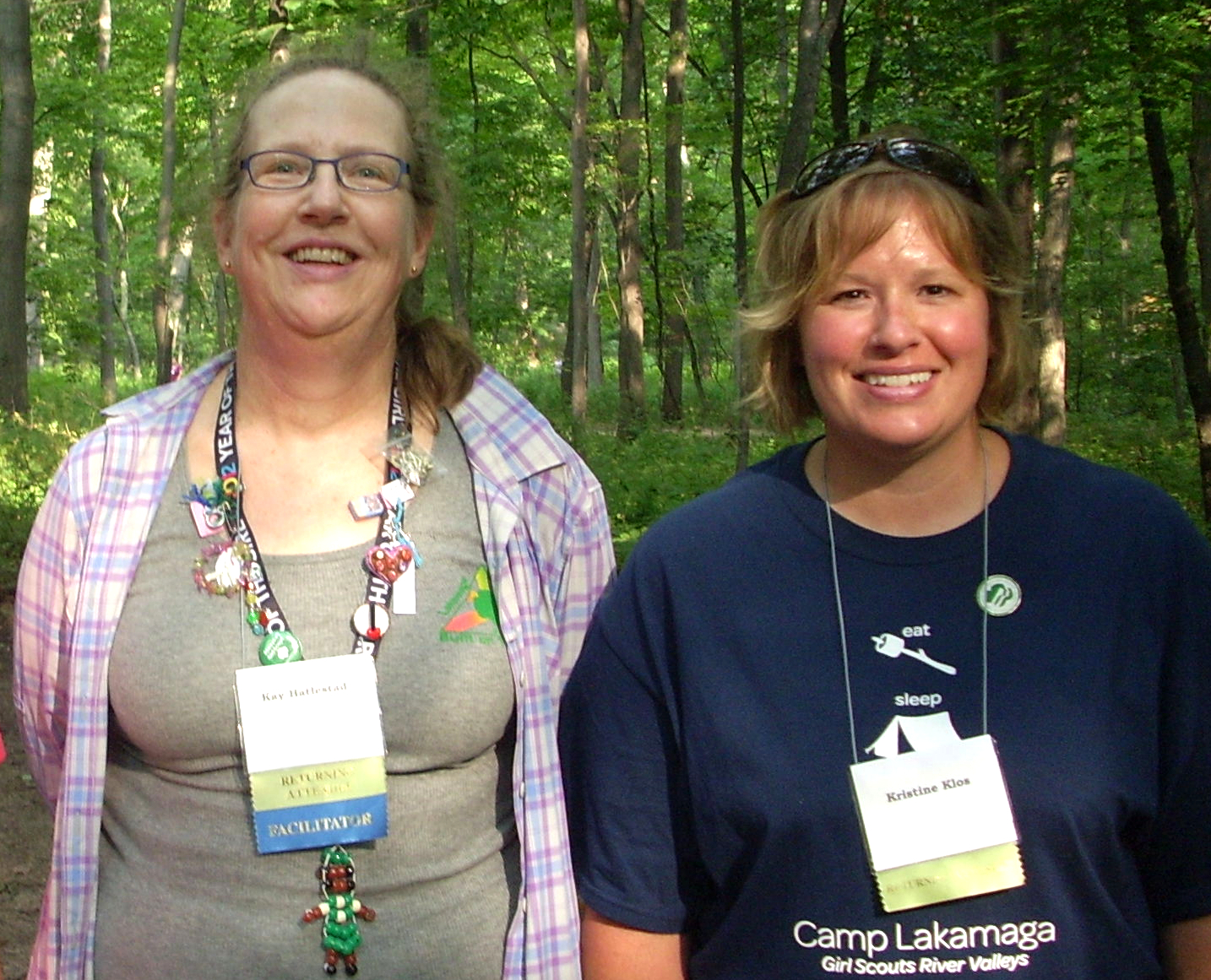
How to connect with us:
On Facebook at:
Girl Scouts River Valleys STEM Alumnae
By email:
Kris Klos at mmmlilacs@gmail.com
Always looking for new members!

