Slide 1

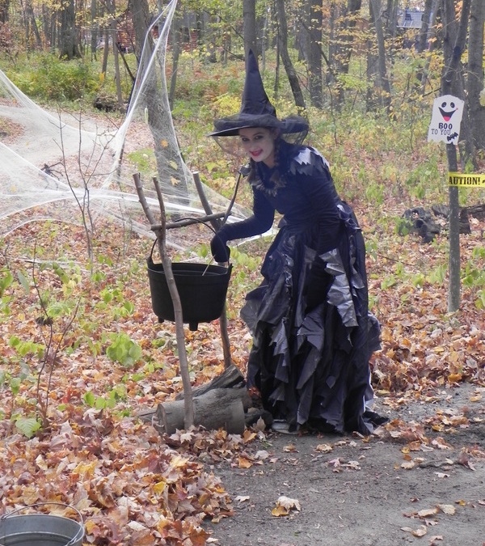
SPOOKAMAGA
AT CAMP LAKAMAGA FOR
SCOUTS AND THEIR FAMILIES
VISIT OUR WEBSITE AT
WWW.CAMPSPOOKAMAGA.COM

Slide 2
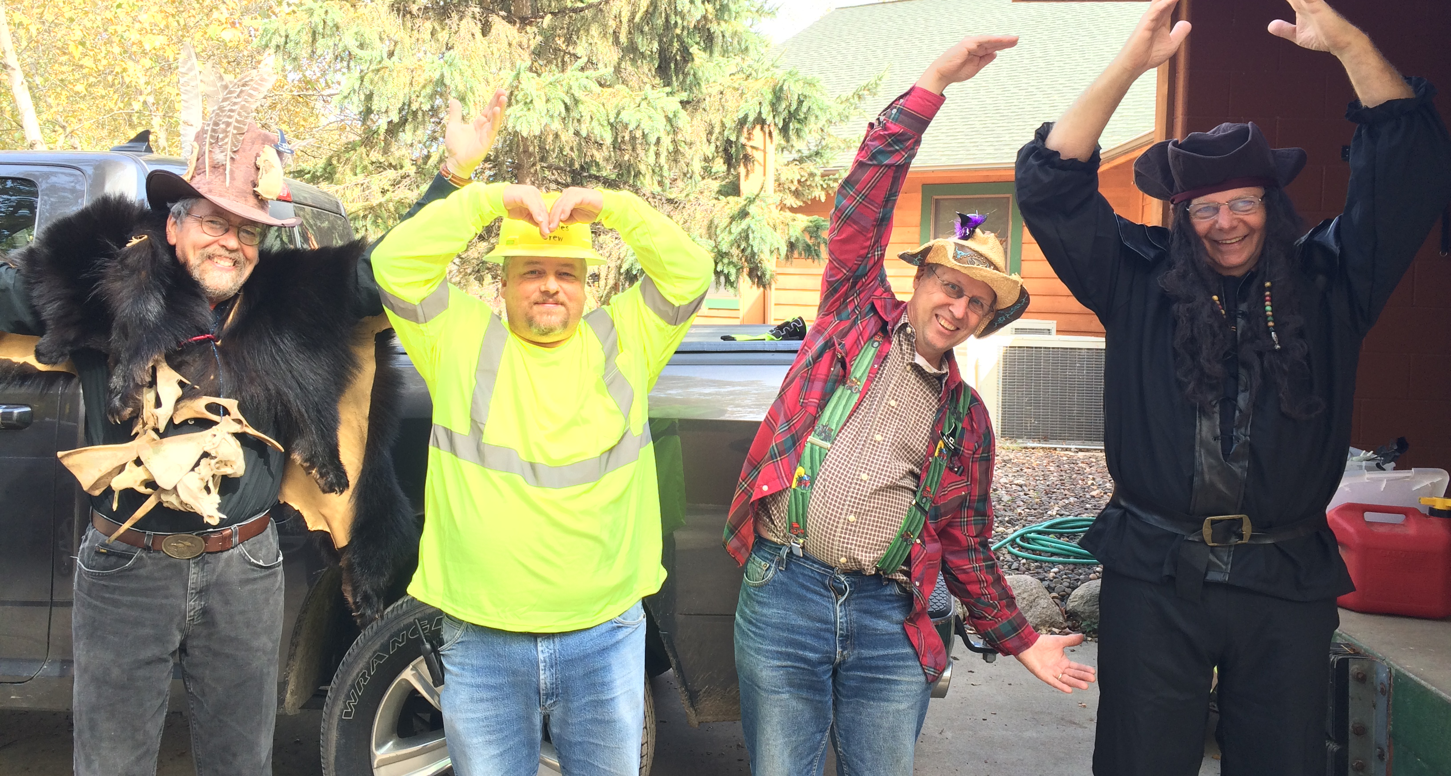
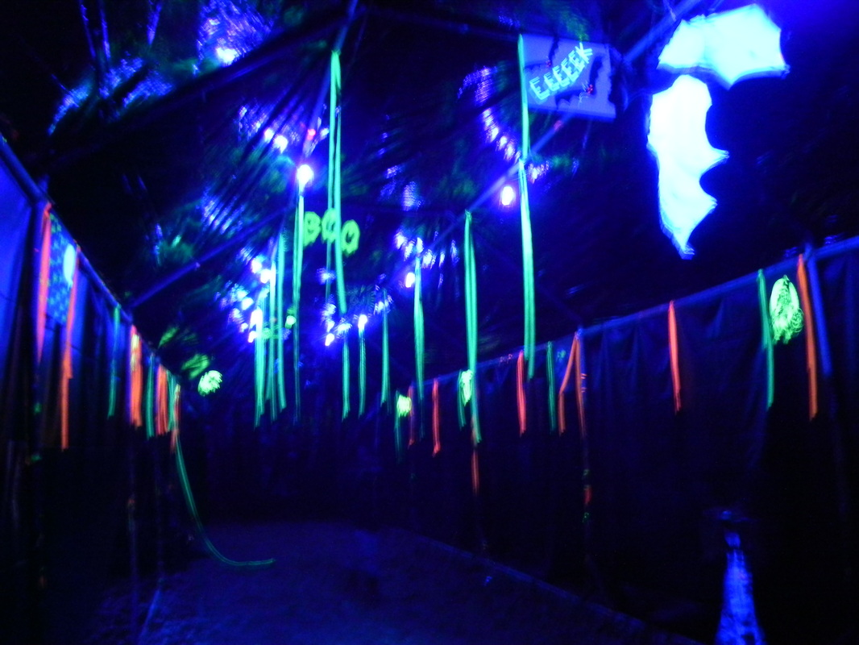
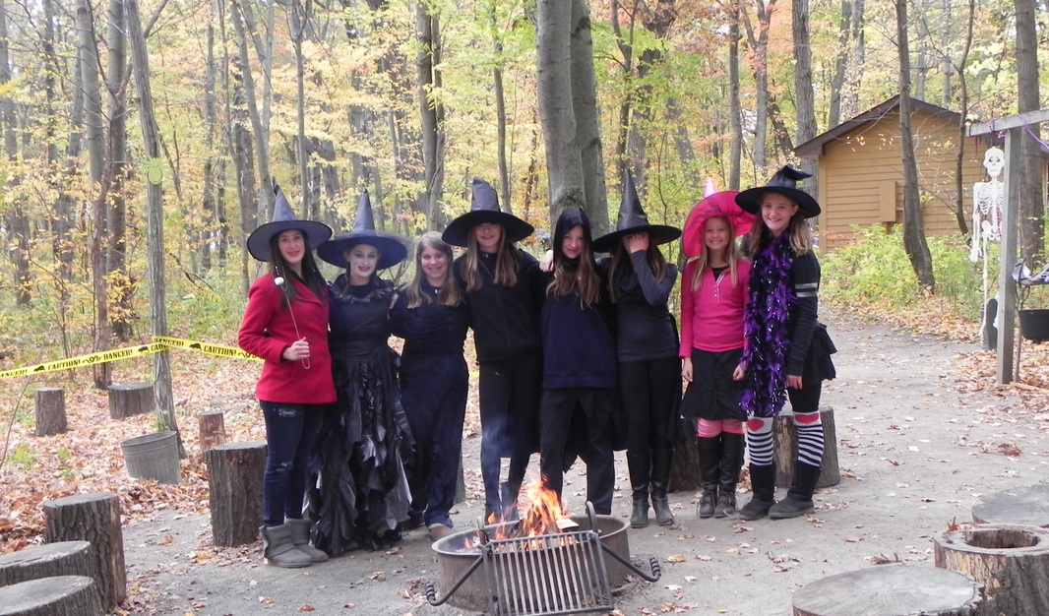
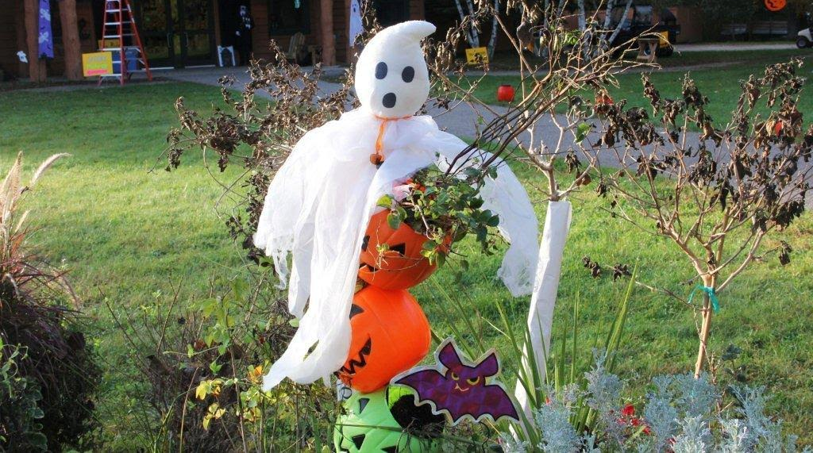

Slide 3
