Slide 1
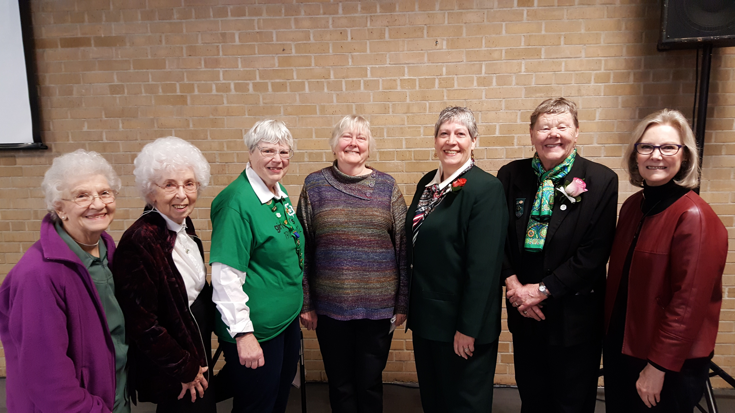
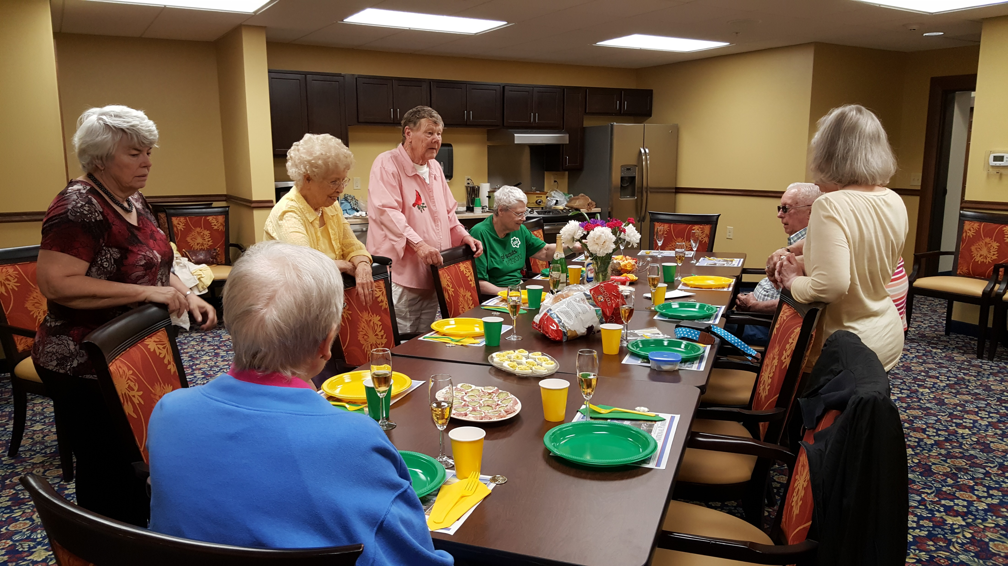
“Troop 1976”
Established in 1976 to support a Girl Scout troop going to The Chalet. Performed as a Kitchen Band to support fundraising events, sponsored World Thinking Day Events, shared Girl Scout traditions with troops, social events to support to our sisters including an annual tea. Several members have received “Forever Green” Award.

Slide 2
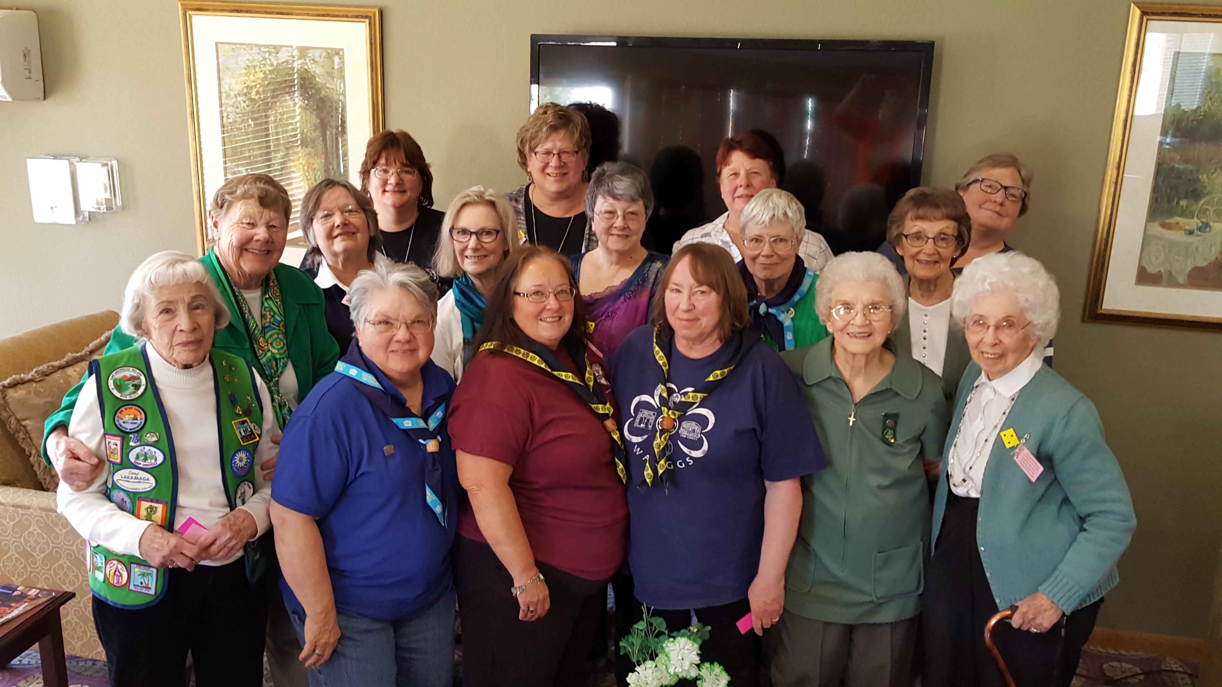
Thinking Day Events

Slide 3
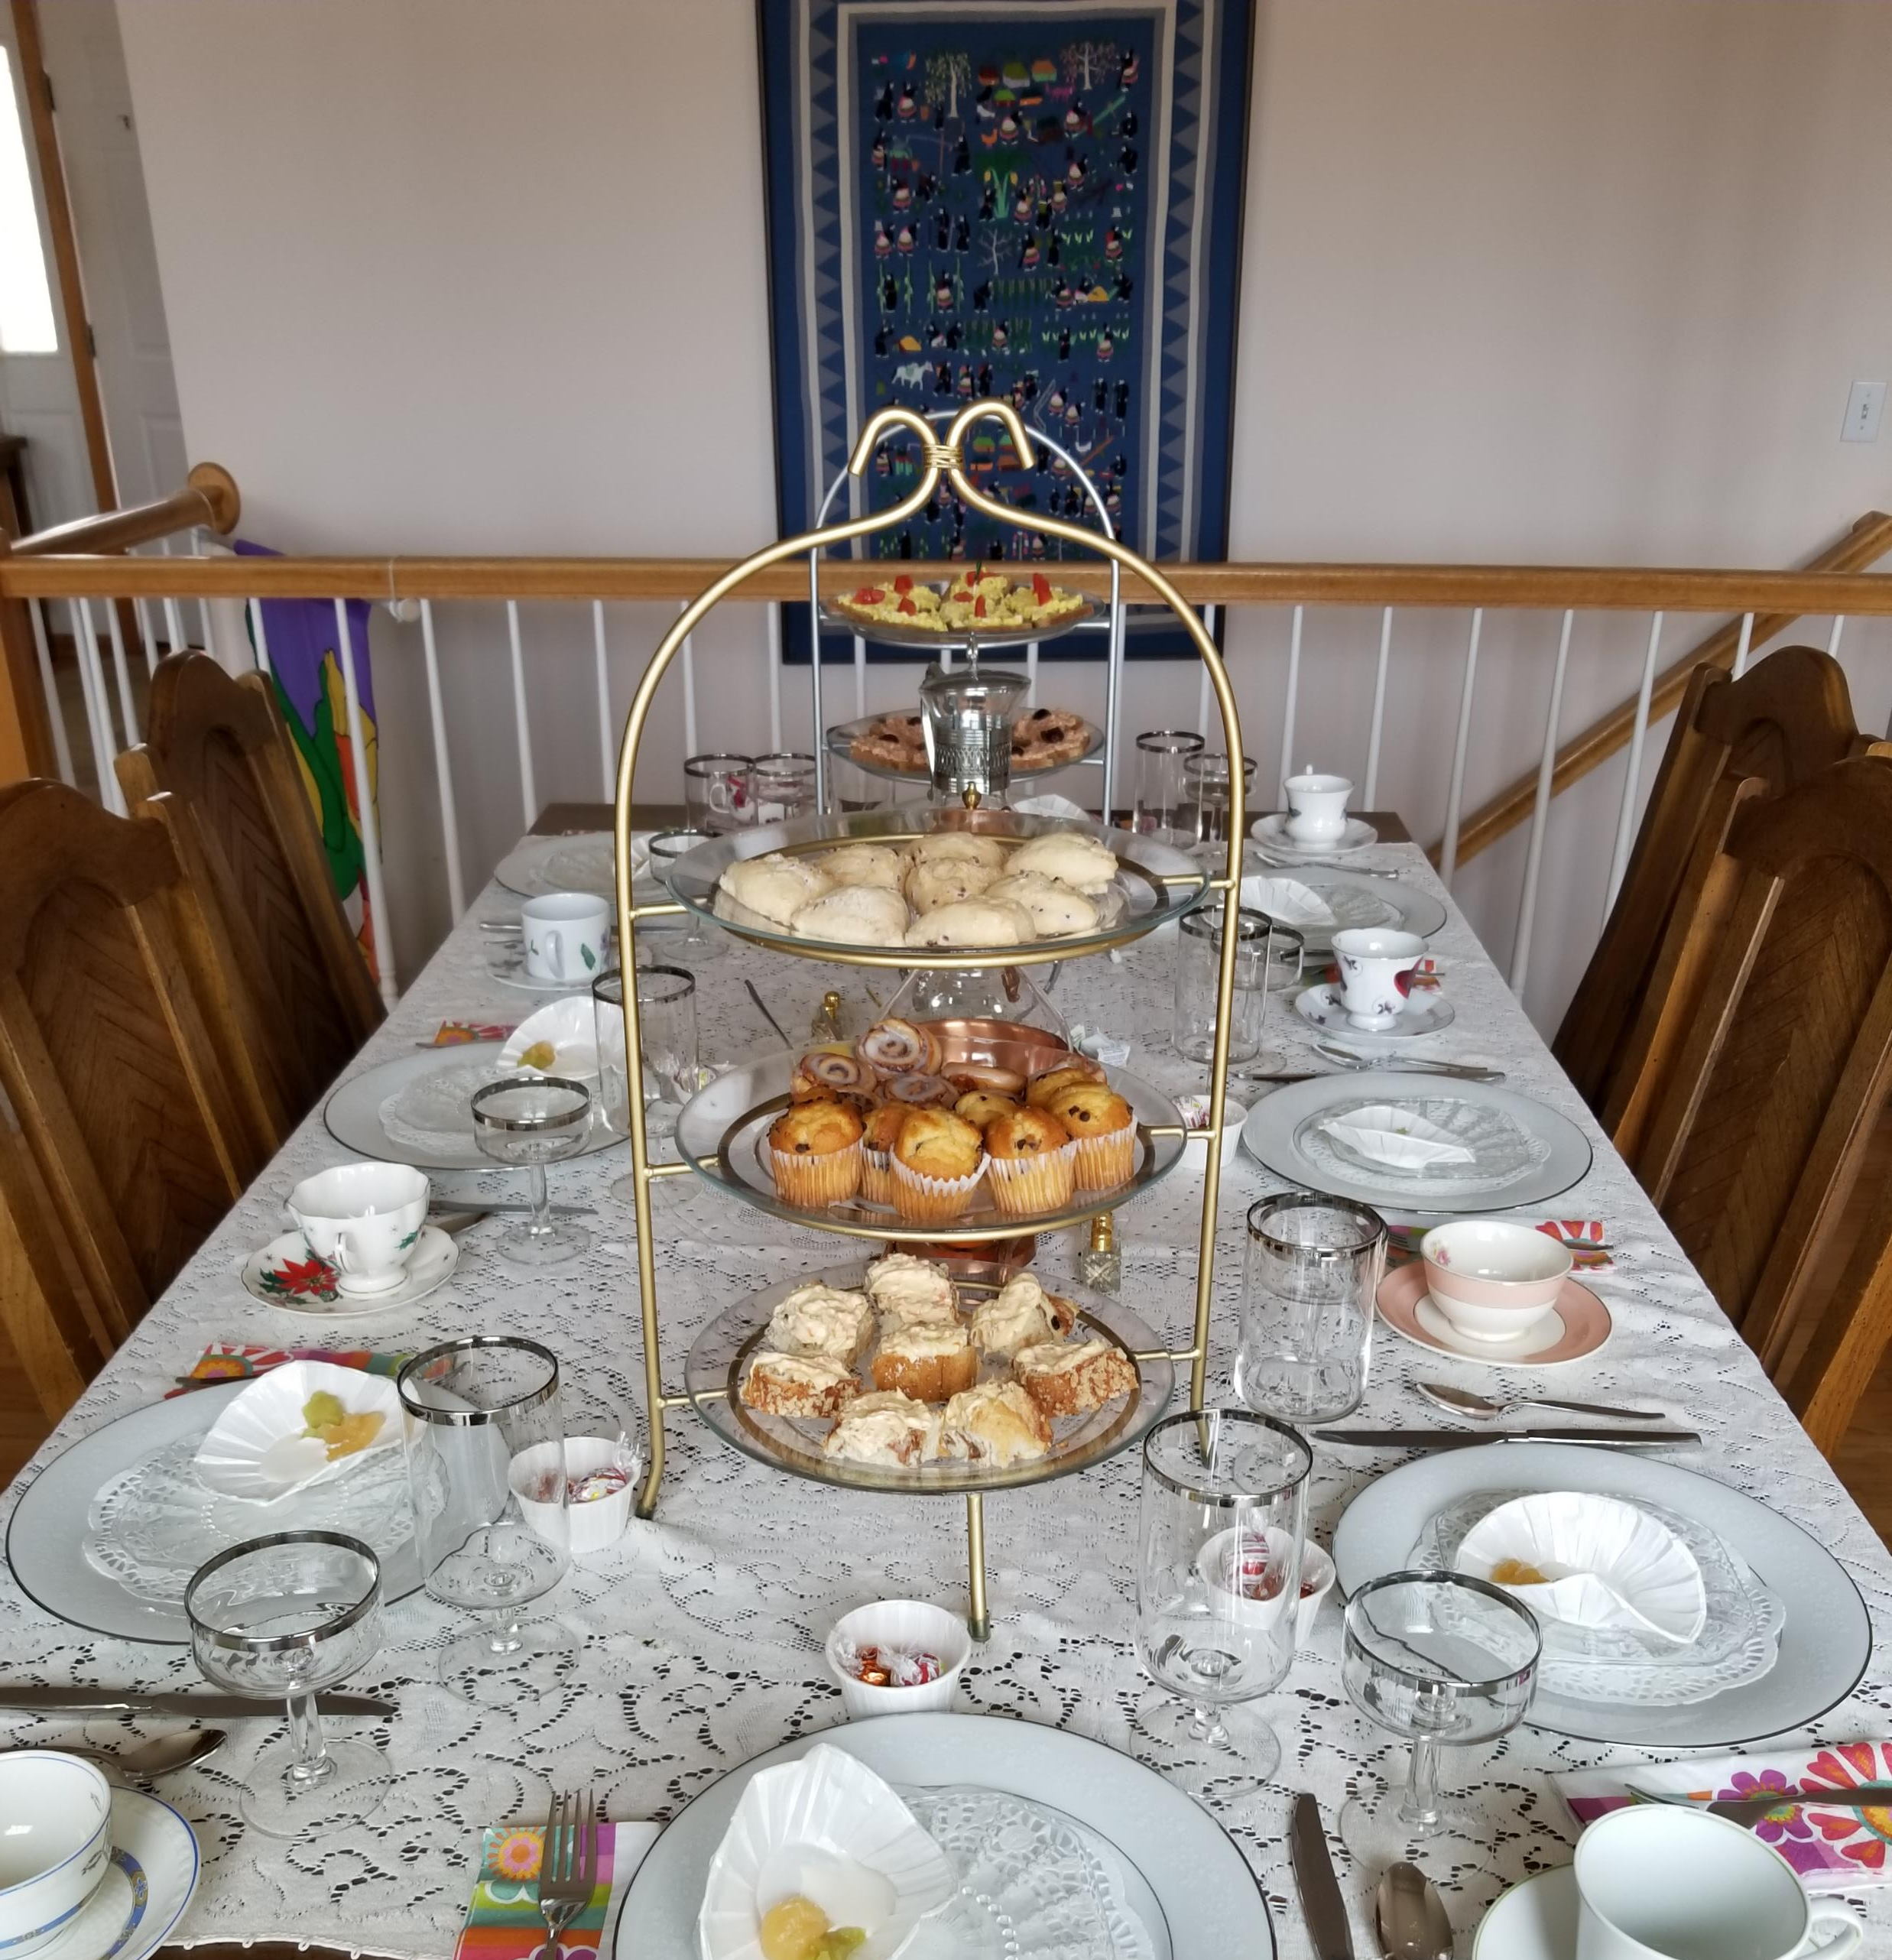
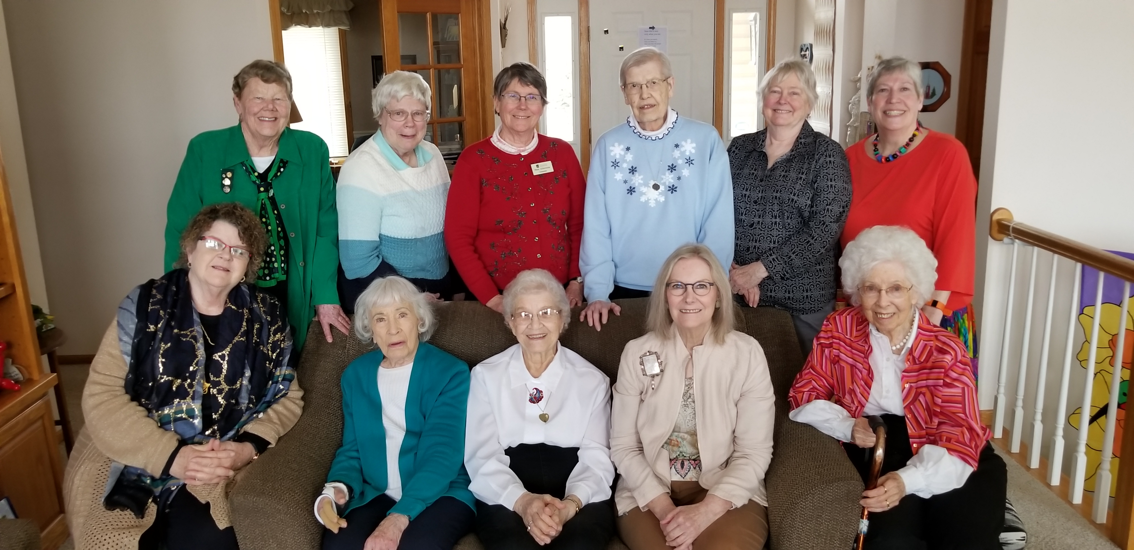
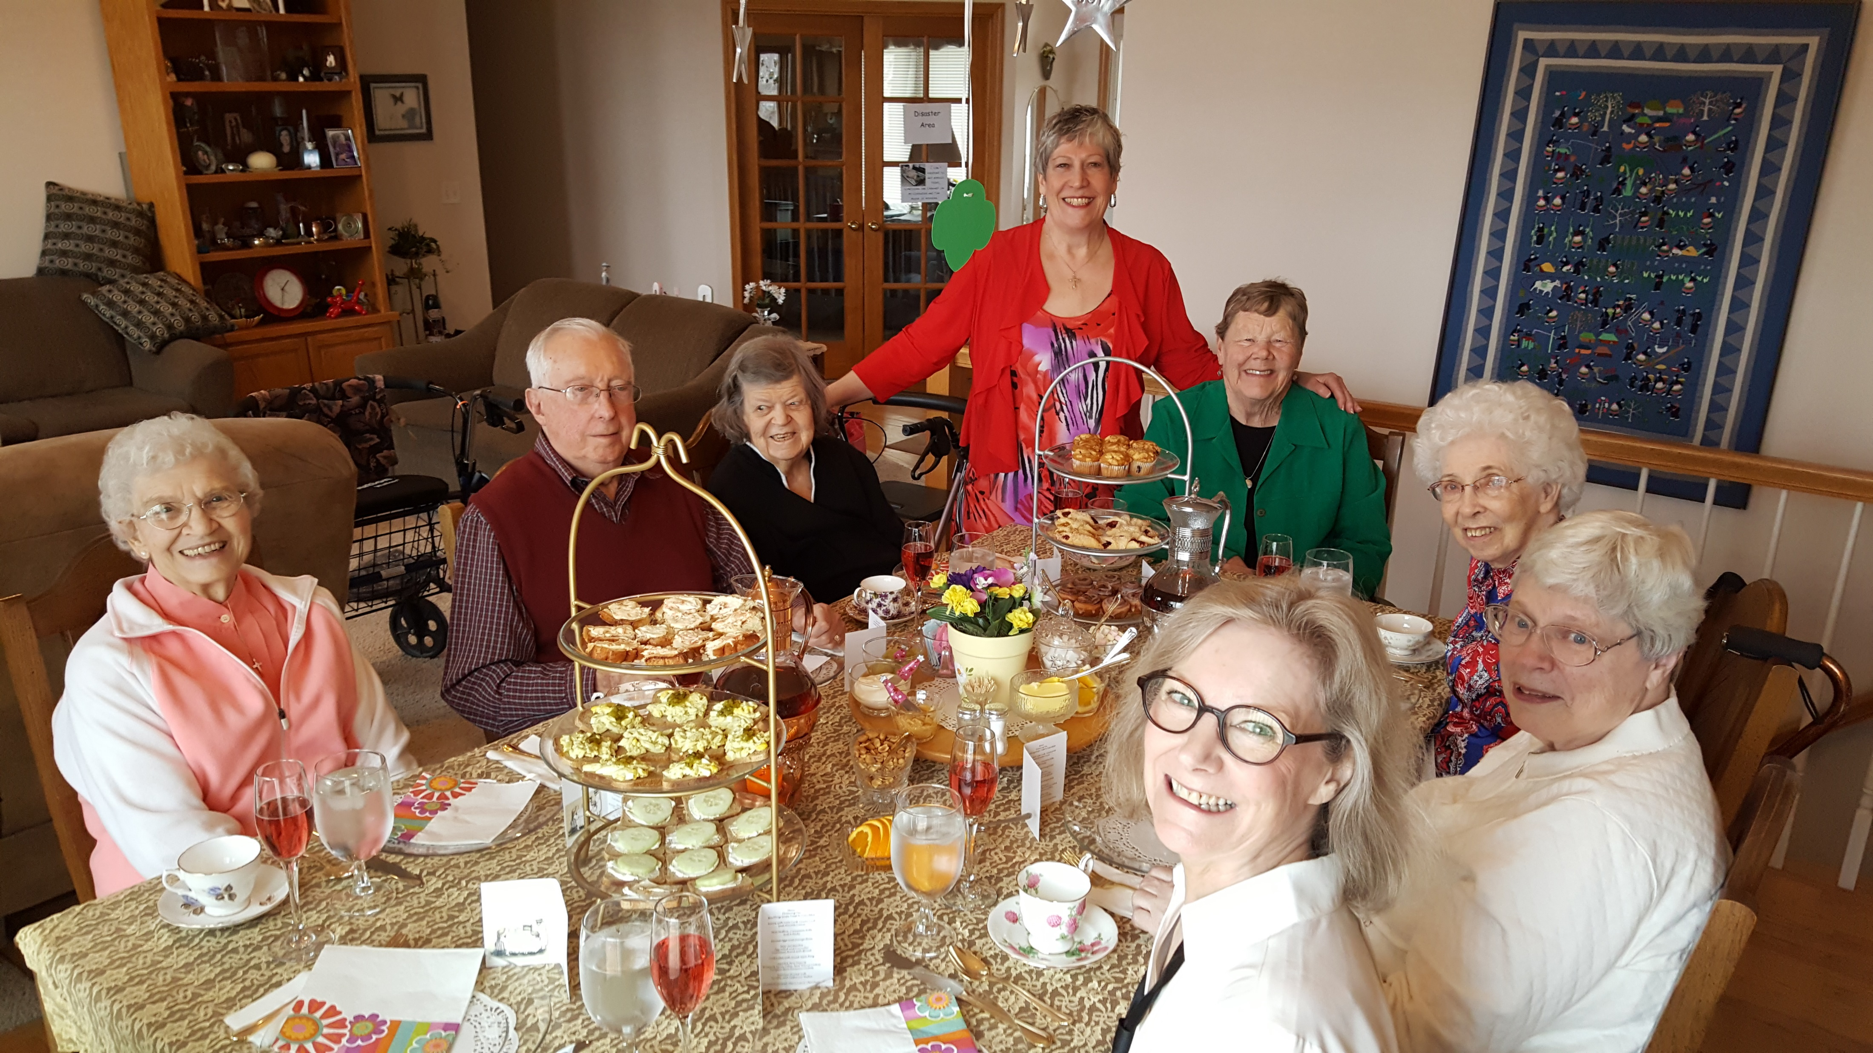
Annual Spring Tea

